Slide 1
Unit-3 Dynamic Programming
CS-402
Analysis Design of Algorithm

Slide 2
Syllabus
Concept of dynamic programming, problems based on this approach such as 0/1 knapsack, multistage graph, reliability design, Floyd-Warshall algorithm
---------------------------------------------------------------
Longest Common Subsequence (Topic beyond the syllabus)

Slide 3
Dynamic Programming (DP)
Dynamic Programming (DP) used to solve optimization problem.
Breaks down the complex problem into smaller subproblems.
Finds optimal solution to these subproblems.
Store the results of subproblem
Memorization: Top-down approach (Recursive)
Tabulation: Bottom-up approach (Iterative)
Reuse the stored result to avoid re-computation.
Finally calculate the result of complex problem.
Applicable to problems which are having properties of:
(i) Overlapping subproblems and (ii) Optimal substructure

Slide 4
Dynamic Programming (DP)
The Principle of Optimality (established by mathematician Richard Bellman) states that an optimal policy or sequence of decisions has the property that whatever the initial state and initial decisions are, the remaining decisions must constitute an optimal policy with regard to the state resulting from the first decision.
In plain terms, an overall optimal solution is built from optimal solutions to its smaller subproblems. It is the foundational concept that allows complex problems to be solved using Dynamic Programming.
Key Characteristics
Sub-problem Optimization: If a route or process is the best possible way to get from Point A to Point C and it passes through Point B, then the path portion from B to C must also be the absolute best possible way to get from B to C.
Memory Efficiency: Instead of blindly re-evaluating all possible future choices, it breaks problems into stages and remembers only the optimal sequence at each step

Slide 5
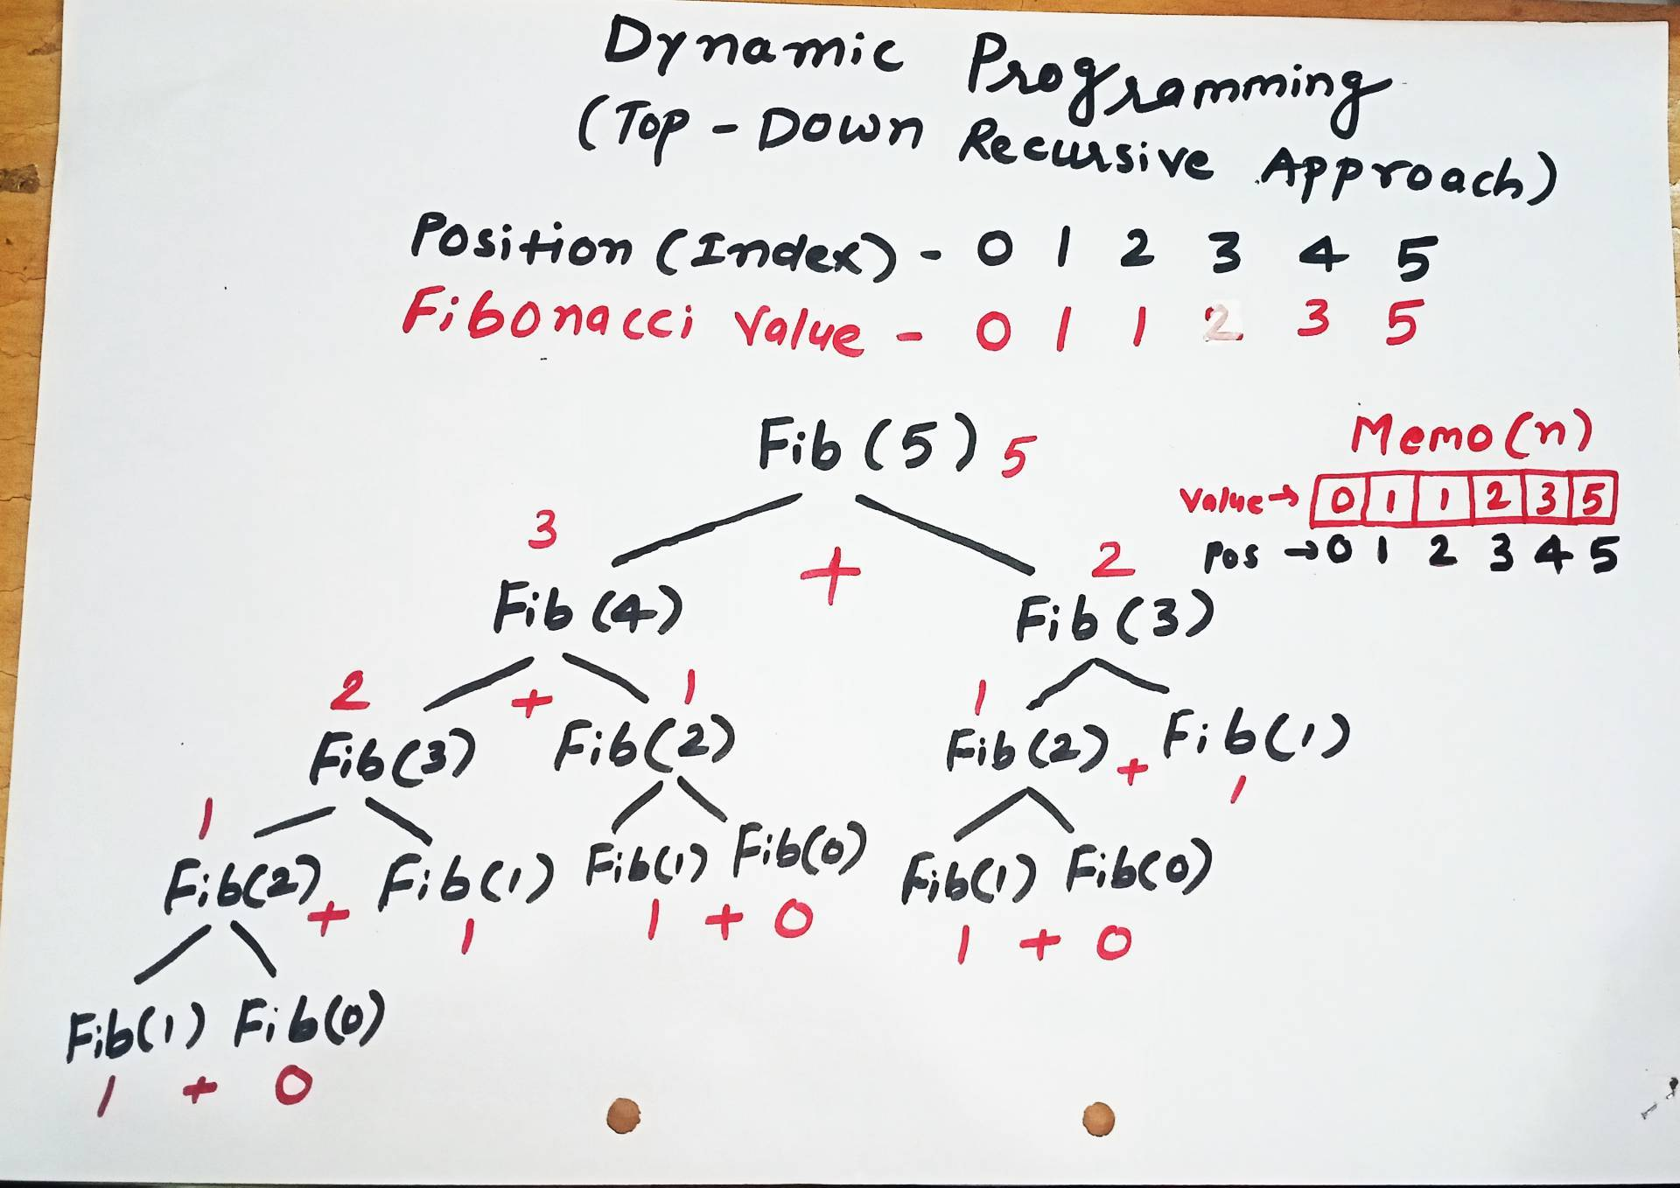
Memorization

Slide 6
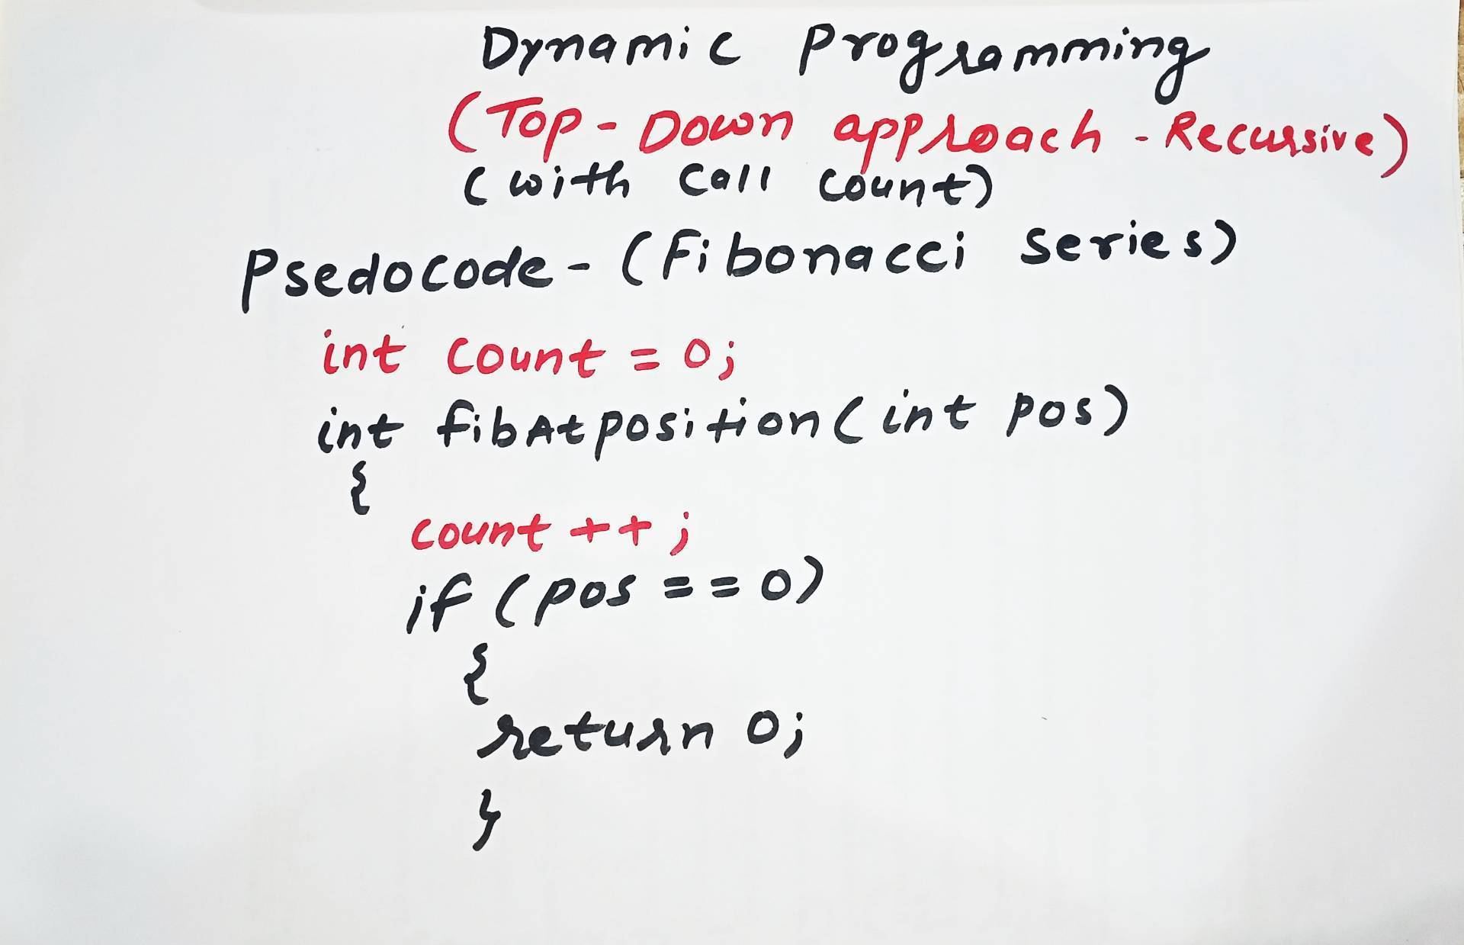
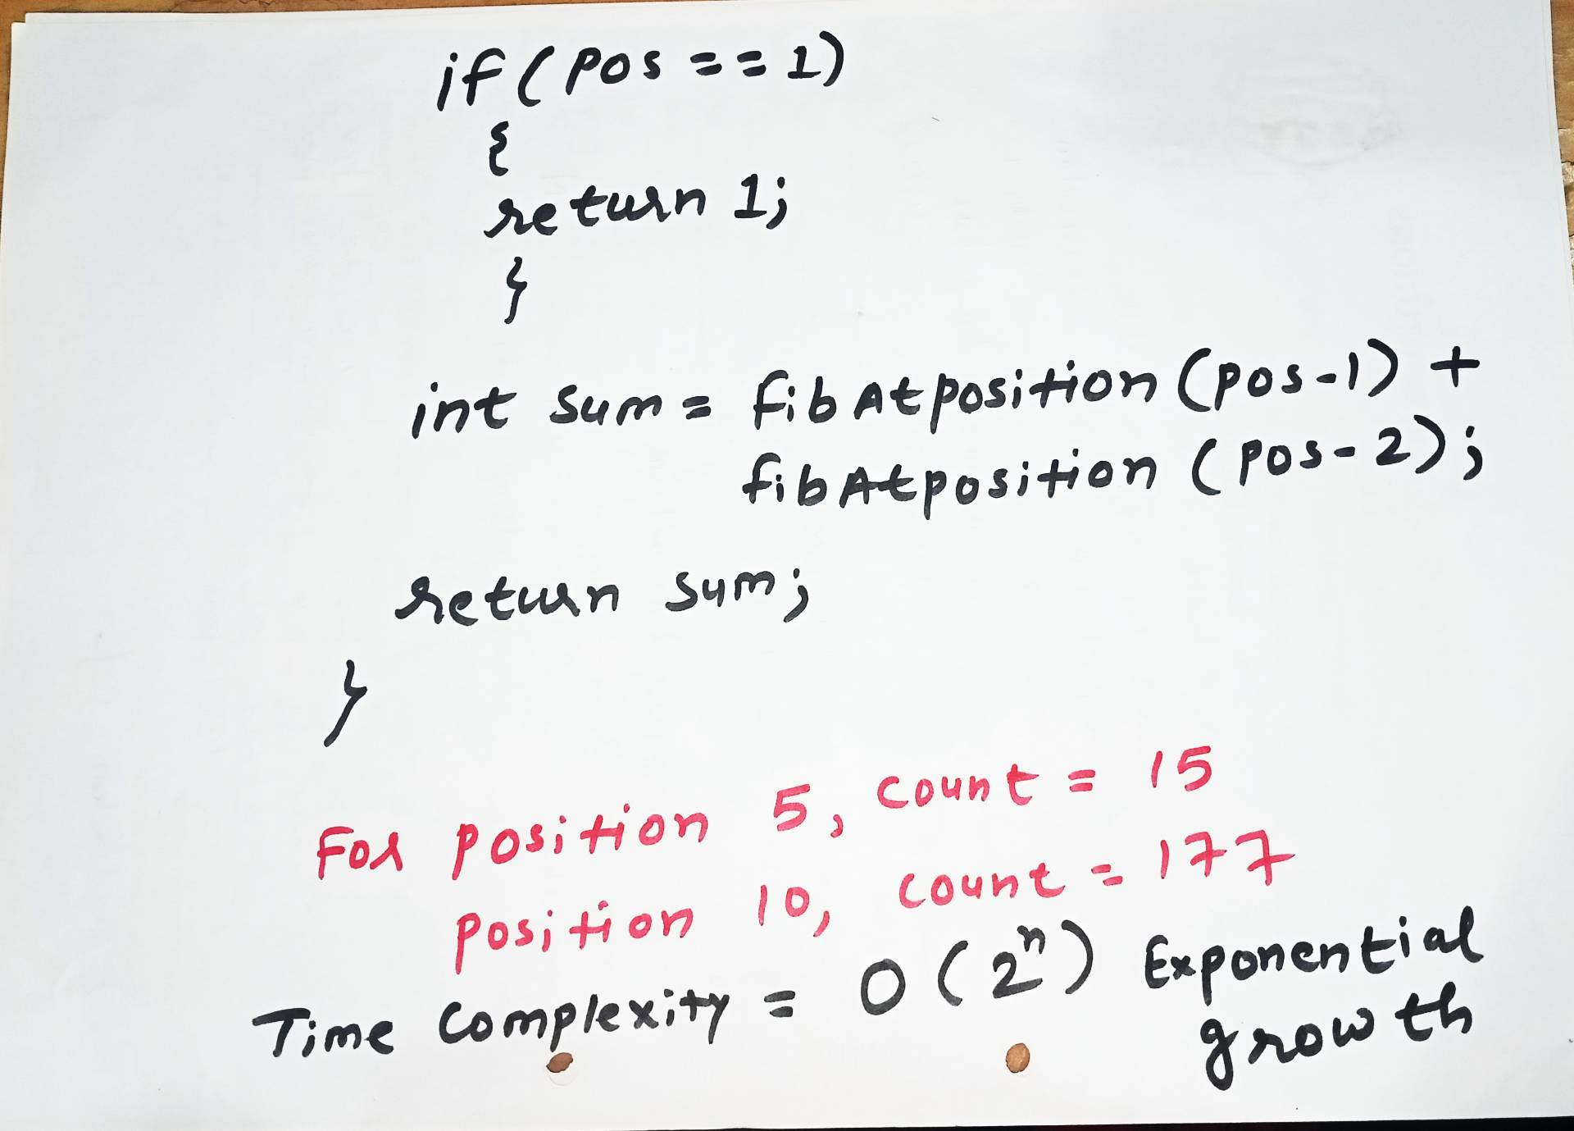
Without Memorization
C Program Link
https://github.com/dayanandyadav205/CS-402-ADA/blob/main/PPT_Notes/Unit-III/Unit-III_Programs/Fibonacci_Series/fib_top_down_recursive_with_callCount.c

Slide 7
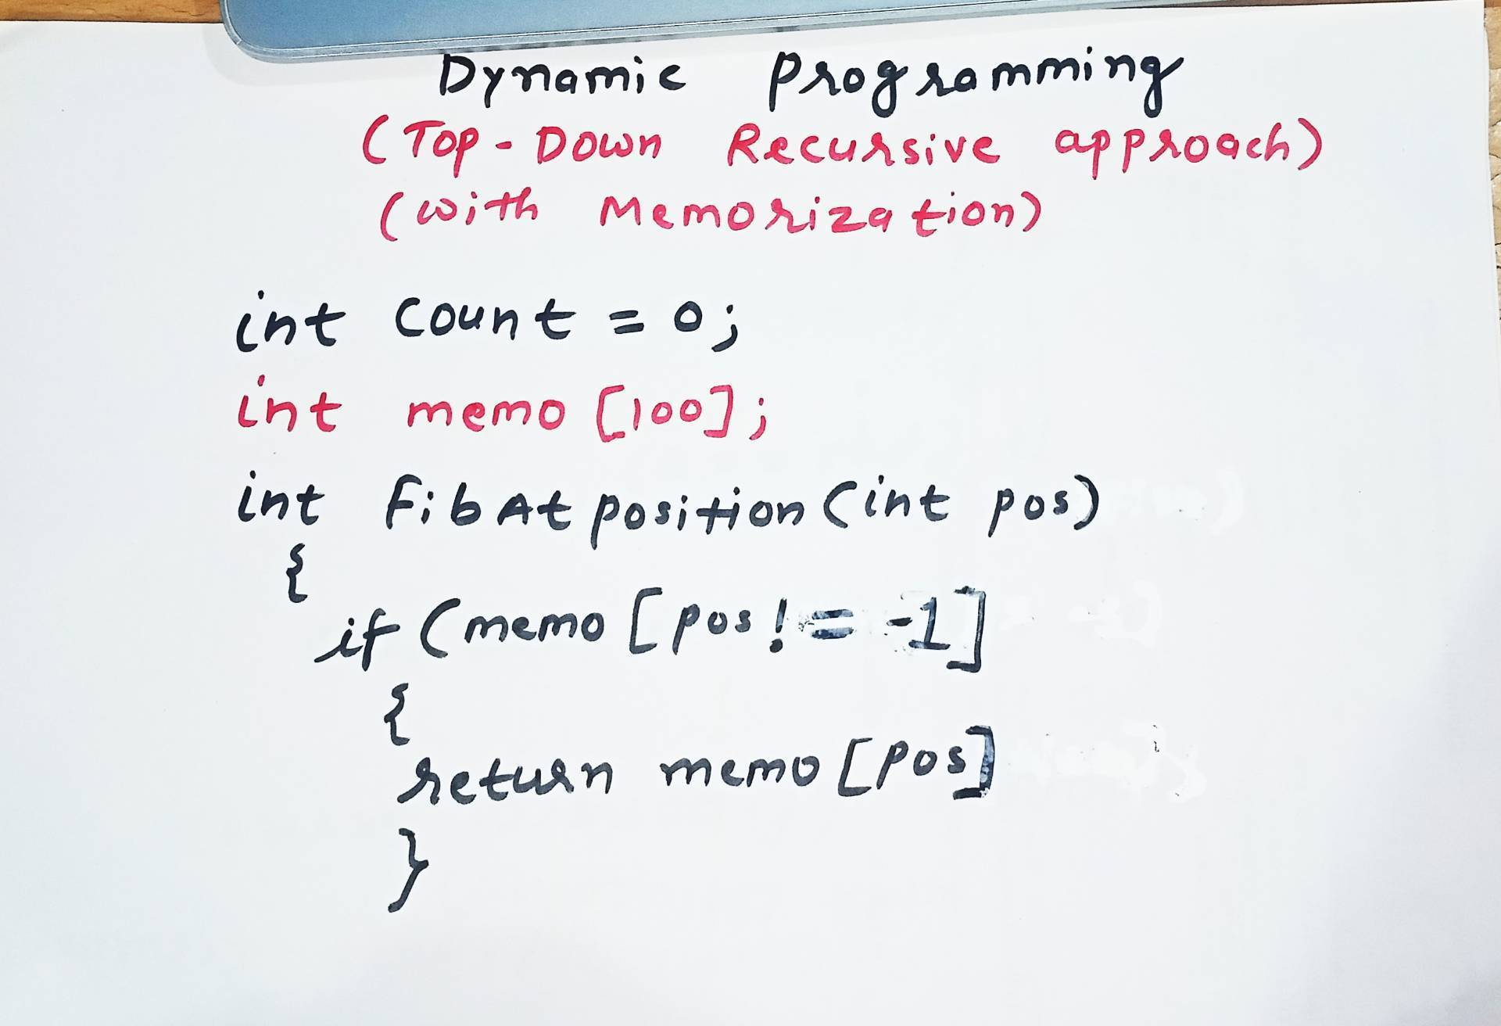
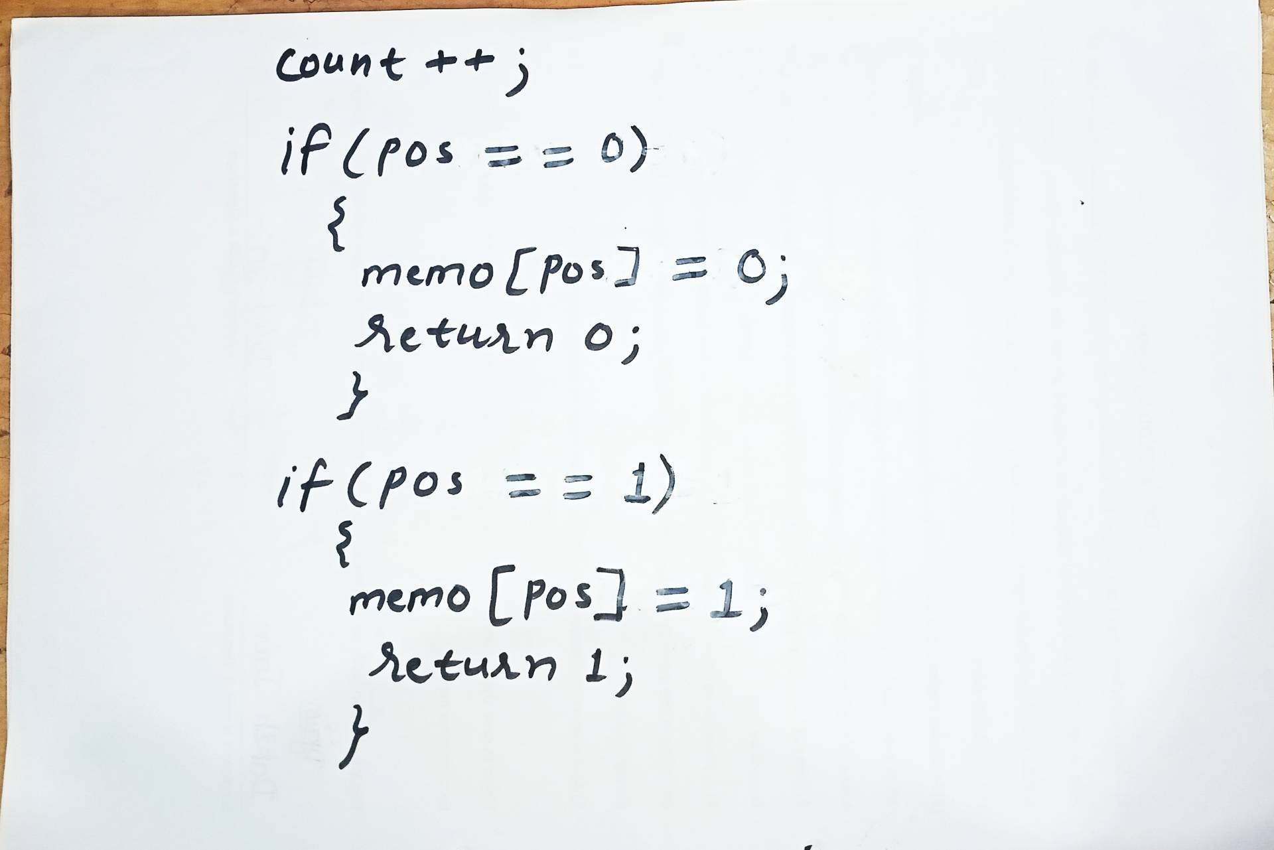
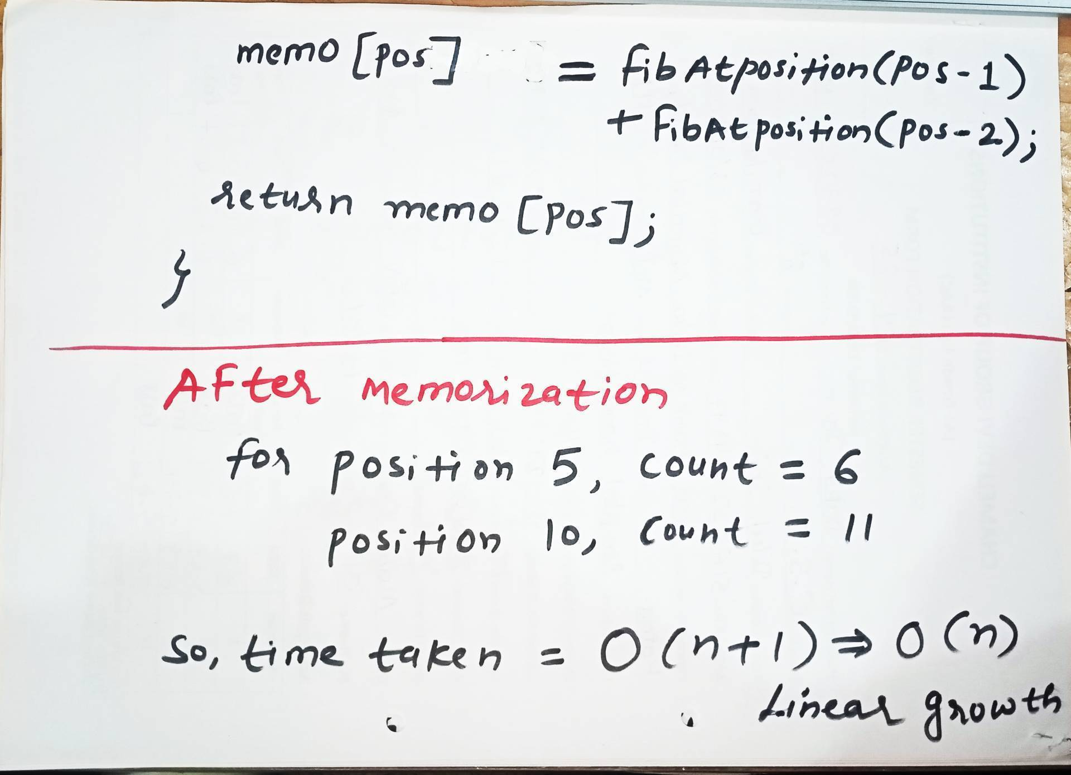
With Memorization
C Program Link
https://github.com/dayanandyadav205/CS-402-ADA/blob/main/PPT_Notes/Unit-III/Unit-III_Programs/Fibonacci_Series/fib_top_down_recursive_memorization.c

Slide 8
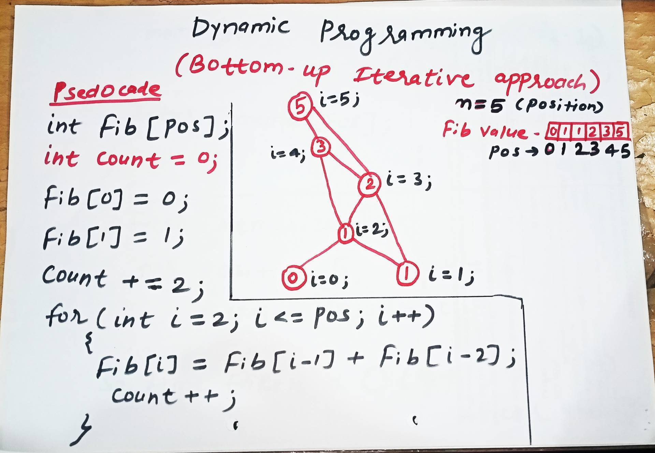
Tabulation
C Program Link
https://github.com/dayanandyadav205/CS-402-ADA/blob/main/PPT_Notes/Unit-III/Unit-III_Programs/Fibonacci_Series/fib_bottom_up_iterative_tabulation.c

Slide 9
Problems based on Dynamic Programming Approach
0/1 knapsack
Multistage graph
Reliability design
Floyd-Warshall algorithm

Slide 10
0/1 Knapsack Problem
The 0/1 Knapsack Problem is a classic optimization problem in computer science where you must select a subset of indivisible items to maximize total value without exceeding a maximum weight capacity. The name "0/1" comes from the rule that you cannot take a fraction of an item; you must either leave it (0) or take it entirely (1).

Slide 11
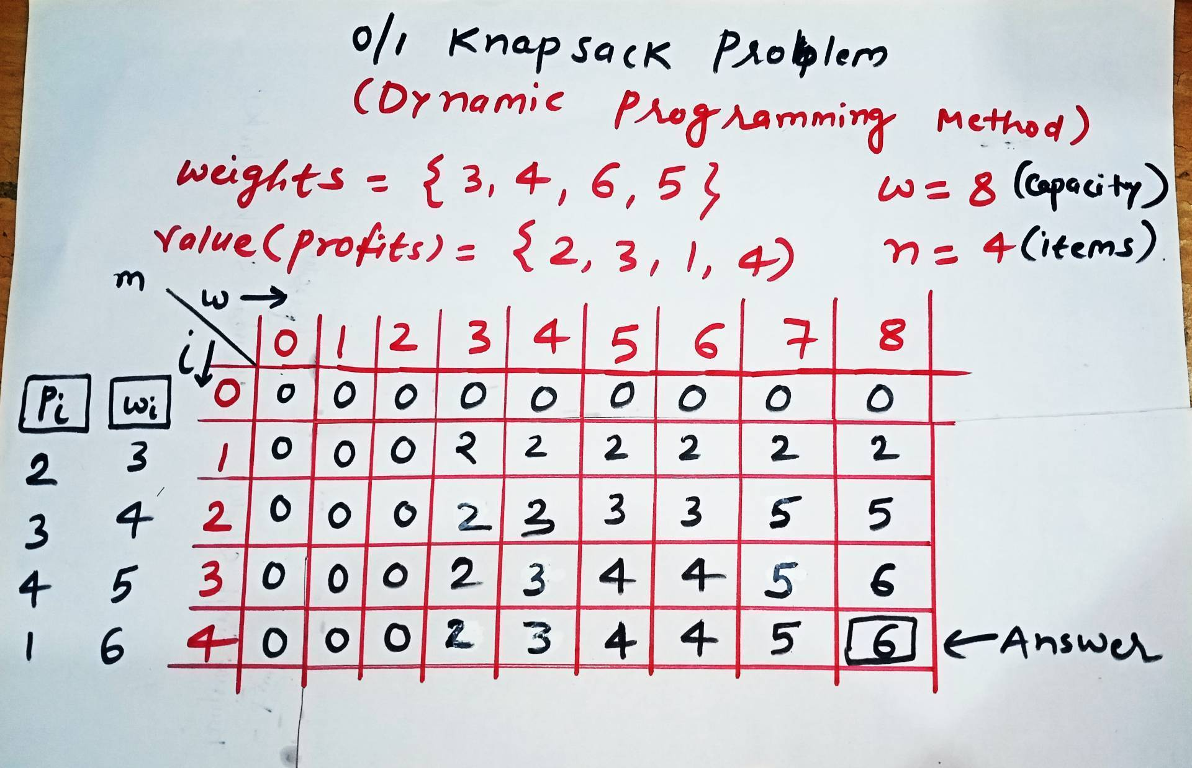
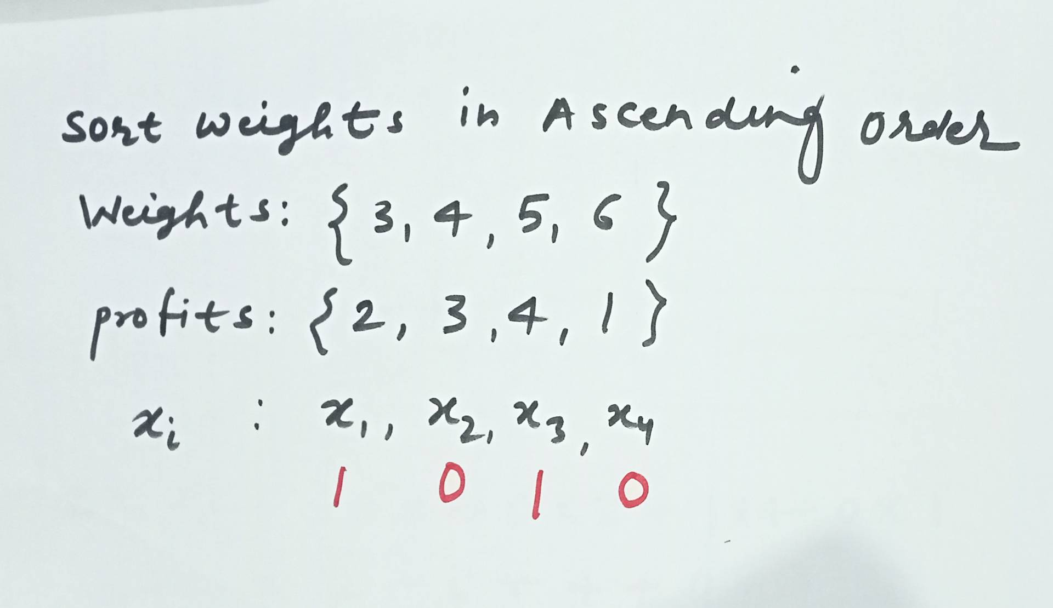
0/1 Knapsack problem

Slide 12
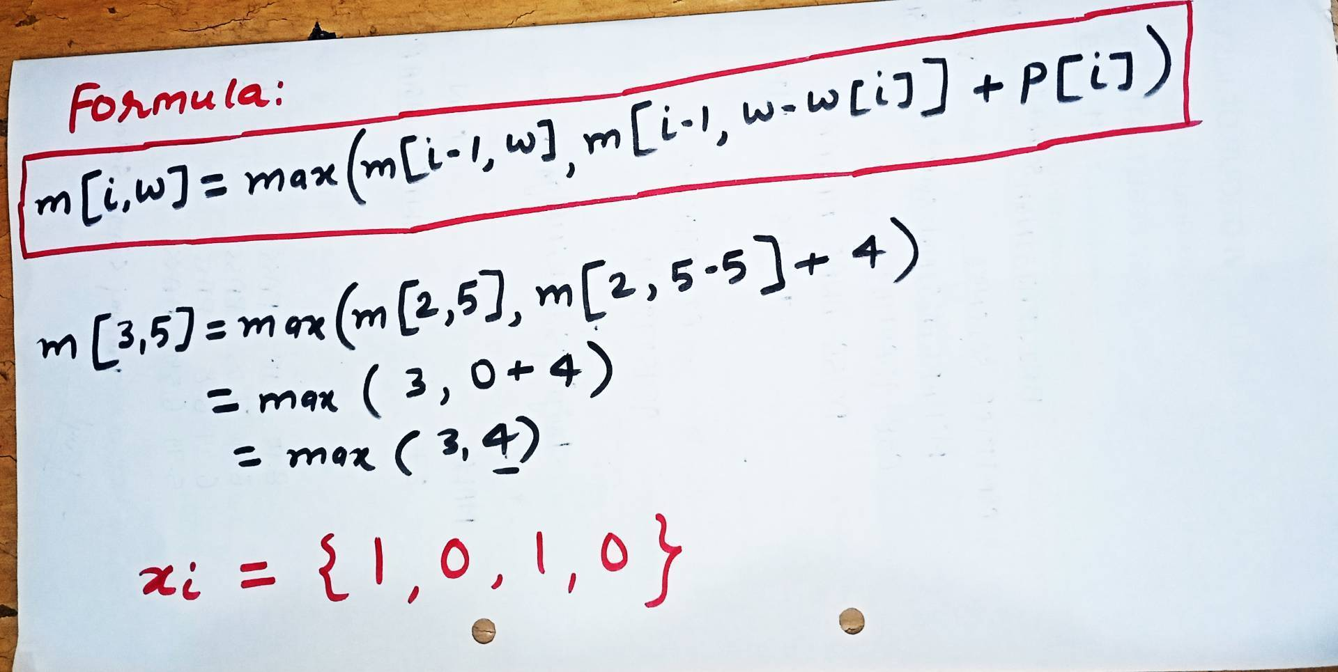
0/1 Knapsack problem

Slide 13
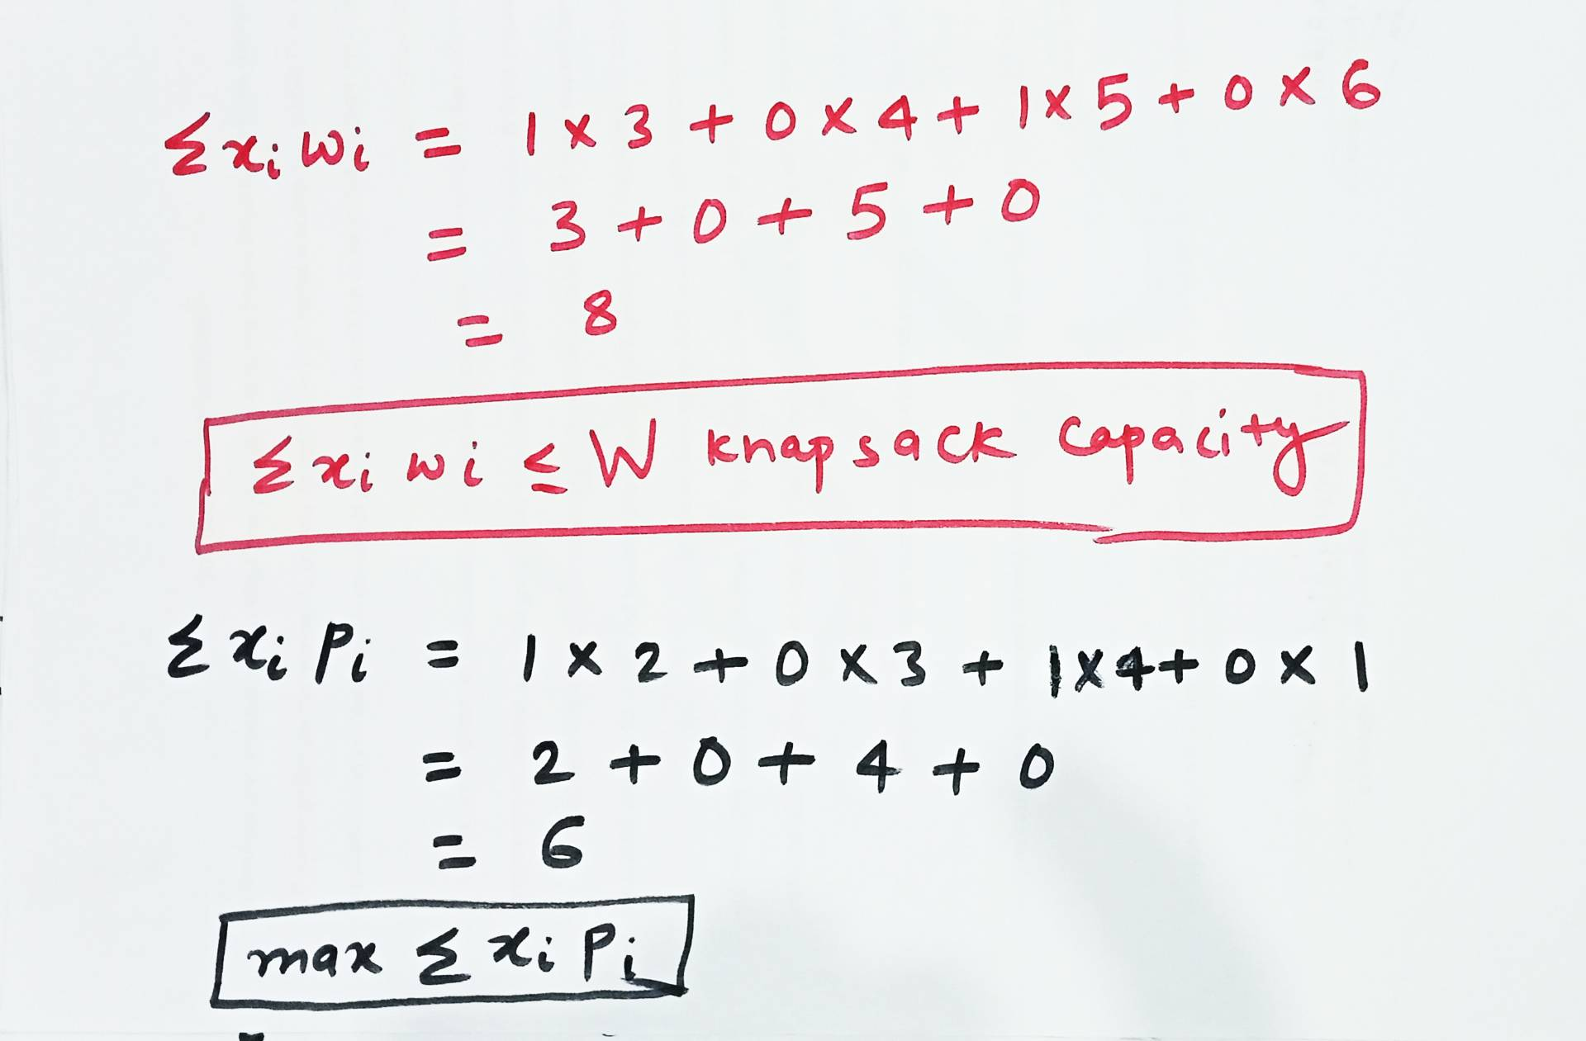
0/1 Knapsack problem
The time complexity of the 0/1 Knapsack problem using dynamic programming is O(N.W)
Here, N represents the total number of items, and W represents the maximum weight capacity of the knapsack.

Slide 14
0/1 Knapsack problem
Example 2
Capacity (W) = 7,
No. of items (n) = 5
Weights | 3 | 2 | 4 | 5 | 1
Profits | 50 | 40 | 70 | 80 | 10
Formula to get max profit for each weight: m[i,w] = max(m[i-1, w], m[i-1, w-w[i]] + p[i])
w
i
0 | 1 | 2 | 3 | 4 | 5 | 6 | 7
0 | 0 | 0 | 0 | 0 | 0 | 0 | 0
0 | 0 | 0 | 50 | 50 | 50 | 50 | 50
0 | 0 | 40 | 50 | 50 | 90 | 90 | 90
0 | 0 | 40 | 50 | 70 | 90 | 110 | 120
0 | 0 | 40 | 50 | 70 | 90 | 110 | 120
0 | 10 | 40 | 50 | 70 | 90 | 110 | 120
xi | pi | wi
x1 | 50 | 3
x2 | 40 | 2
x3 | 70 | 4
x4 | 80 | 5
x5 | 10 | 1
0
1
2
3
4
5
xi | x1 | x2 | x3 | x4 | x5
Selected objects | 1 | 0 | 1 | 0 | 0
Max(∑xipi) = 1x50 + 0x40 + 1x70 + 0x80 + 0x10 = 120 (Max Profit)
(∑xiwi<=W) = 1x3 + 0x2 + 1x4 + 0x5 + 0x1 = 7 (Max capacity)

Slide 15
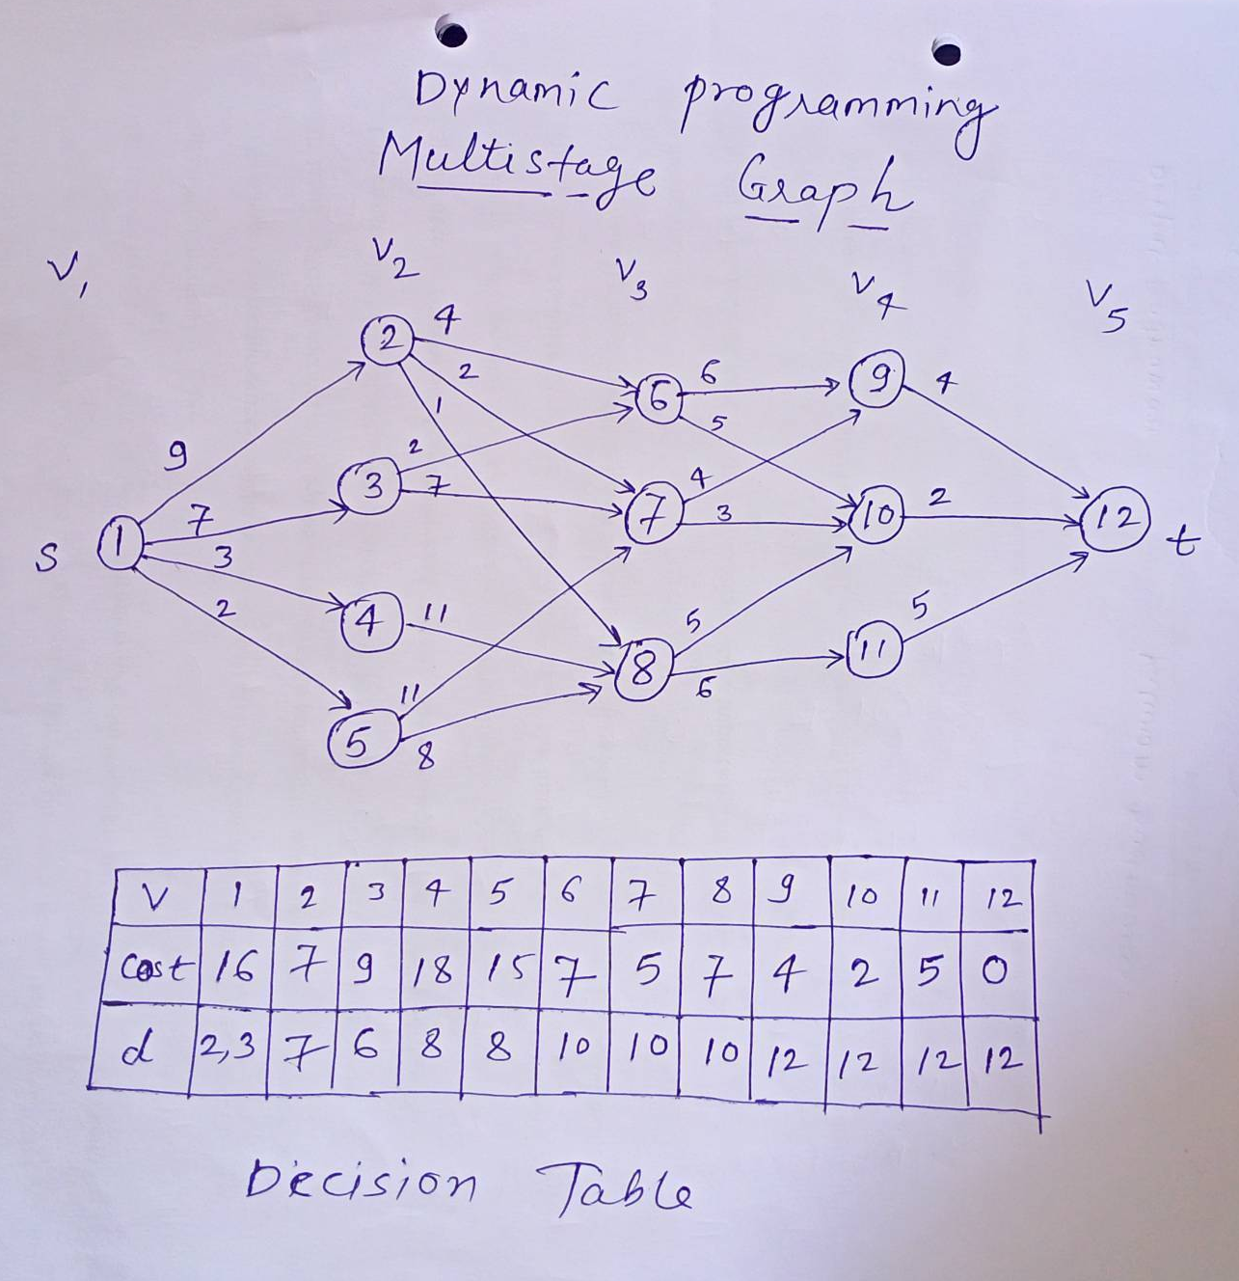
Multistage graph
A Multistage graph is a directed, weighted graph in which the nodes can be divided into a set of stages such that all edges are from a stage to next stage only (In other words there is no edge between vertices of same stage and from a vertex of current stage to previous stage).

Slide 16
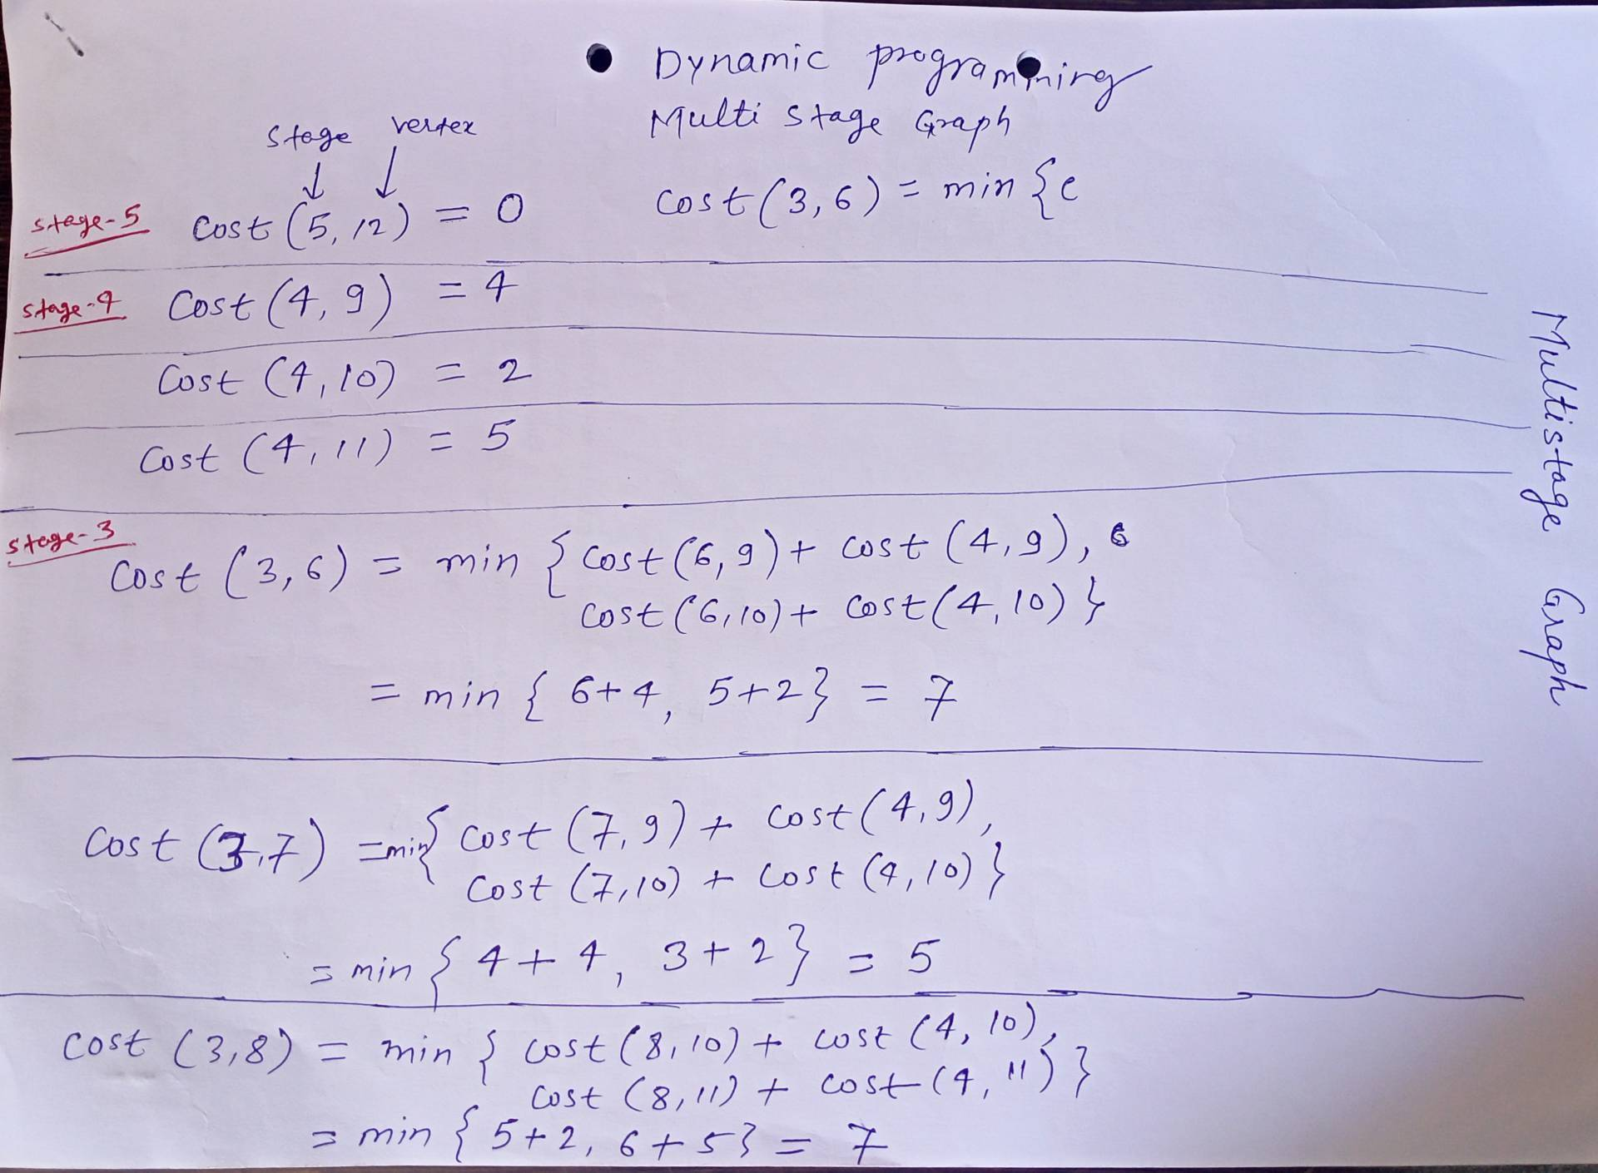




Multistage graph

Slide 17
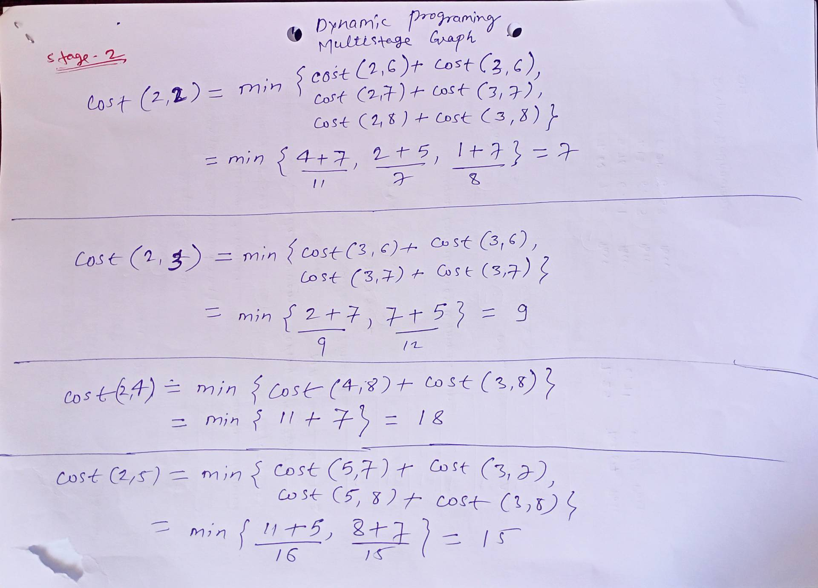
Multistage graph

Slide 18
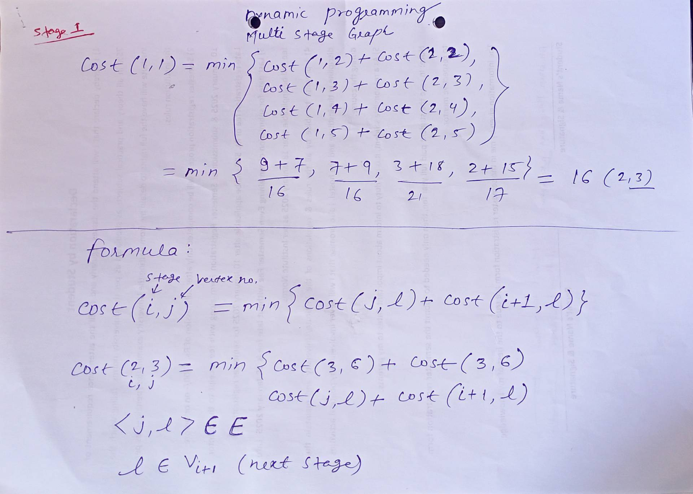
Multistage graph

Slide 19
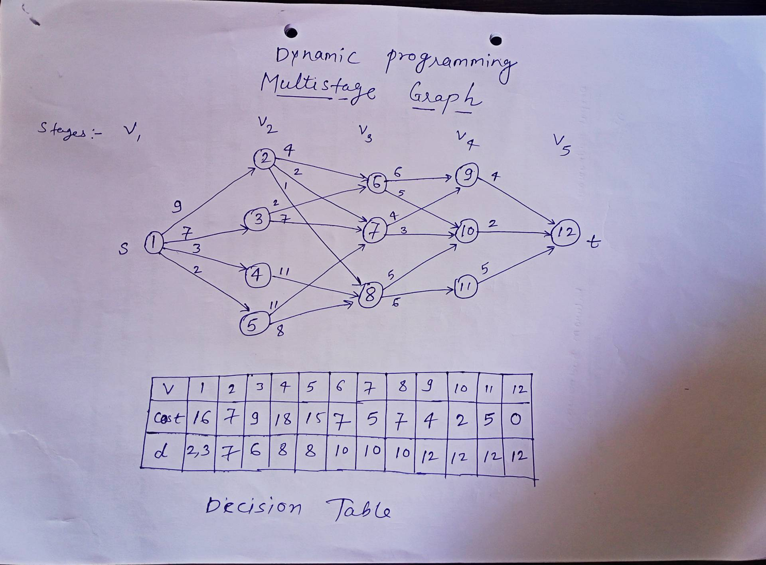
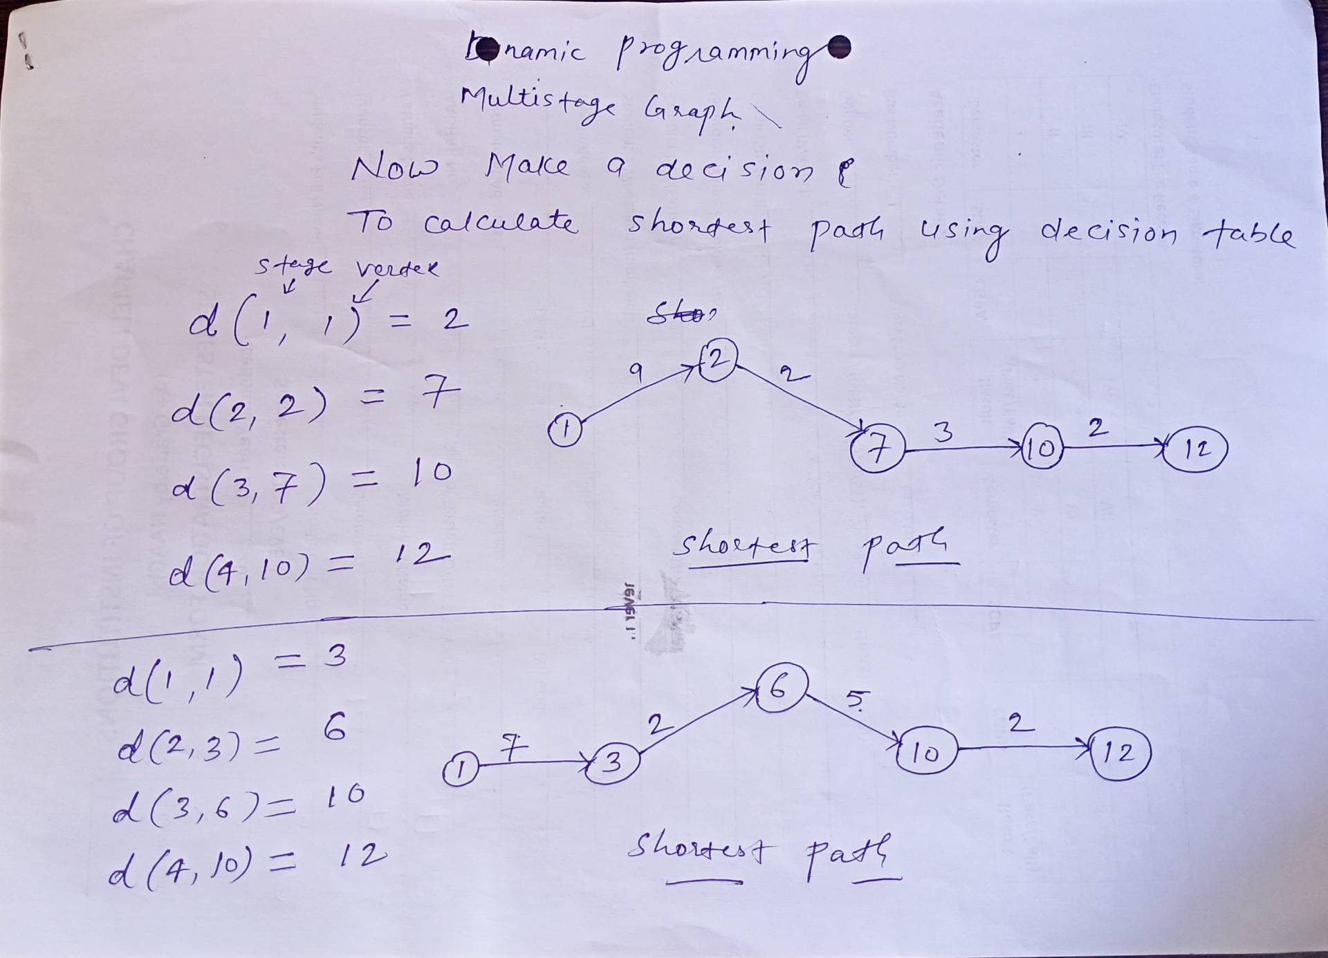
Multistage graph
The total time complexity of solving the multistage graph shortest path problem using dynamic programming is O(|V| + |E|)
Where,
|V| = no. of vertex
|E| = no. of edges

Slide 20
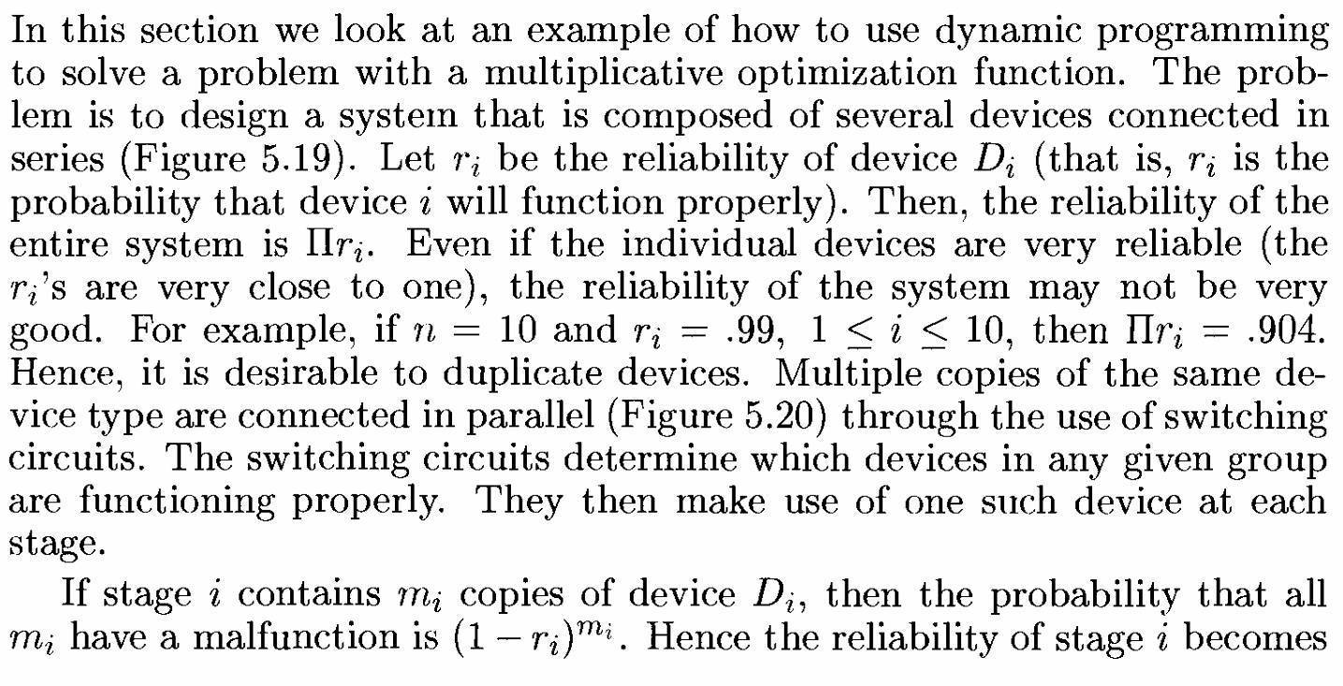
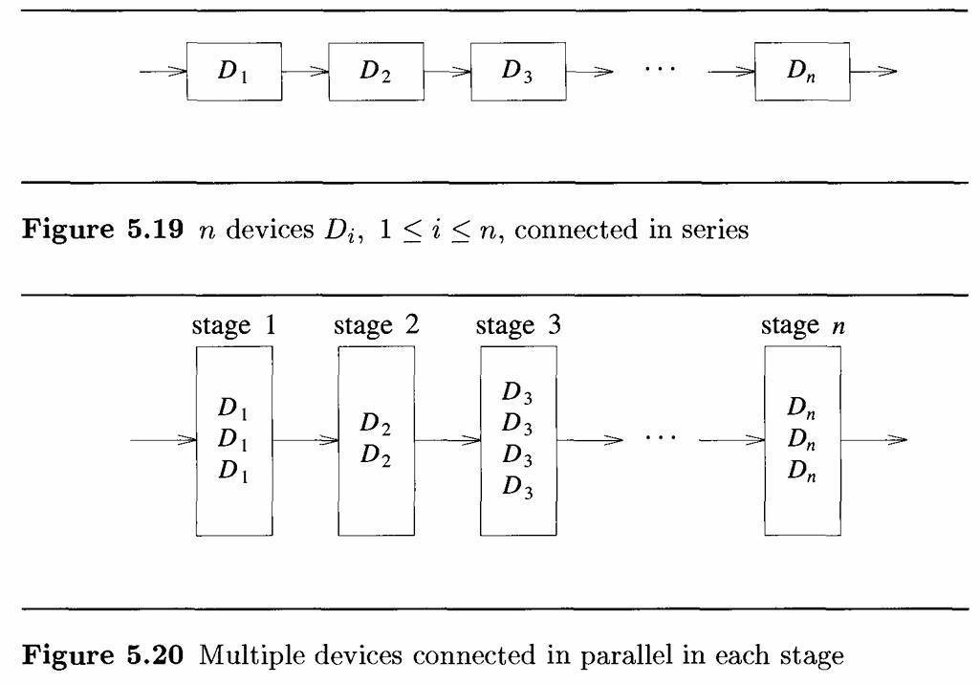
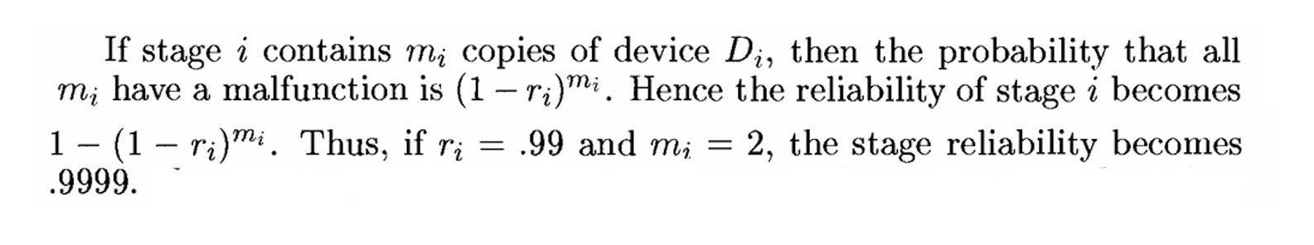
Reliability Design

Slide 21
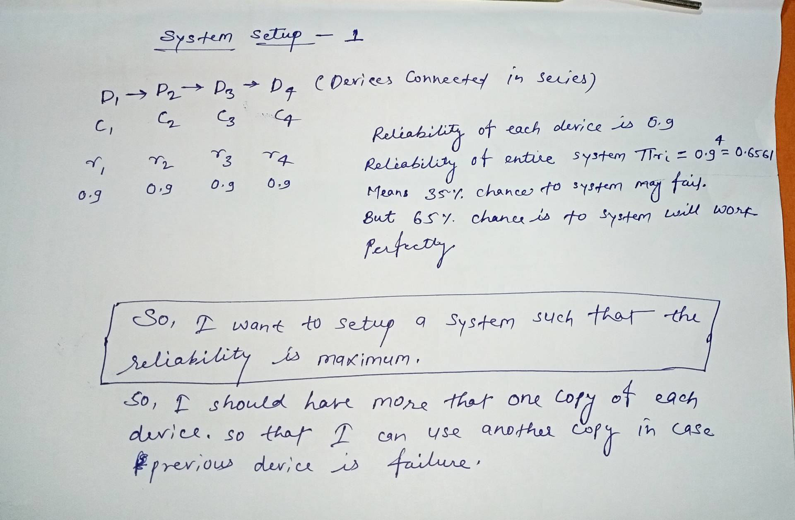
Reliability Design

Slide 22
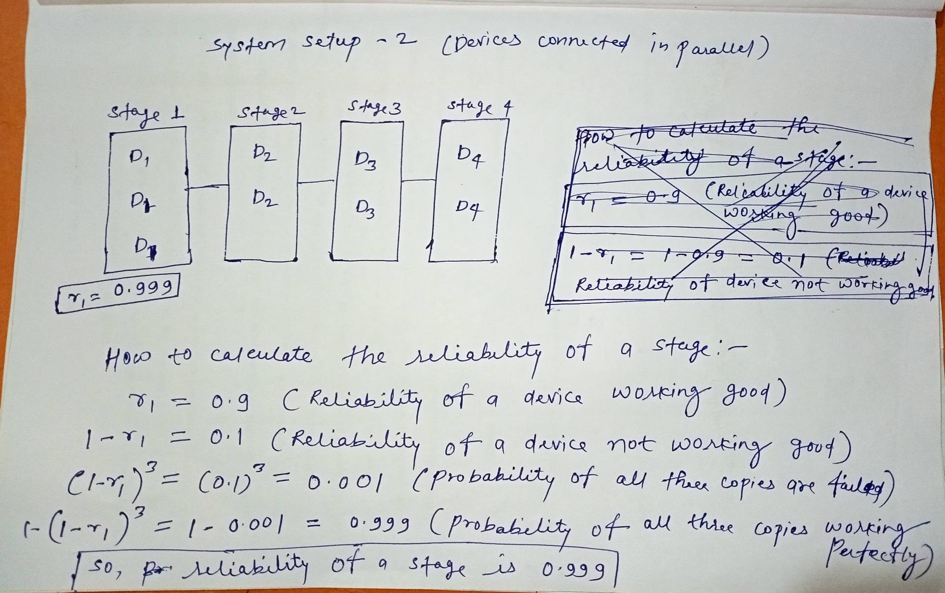
Reliability Design

Slide 23
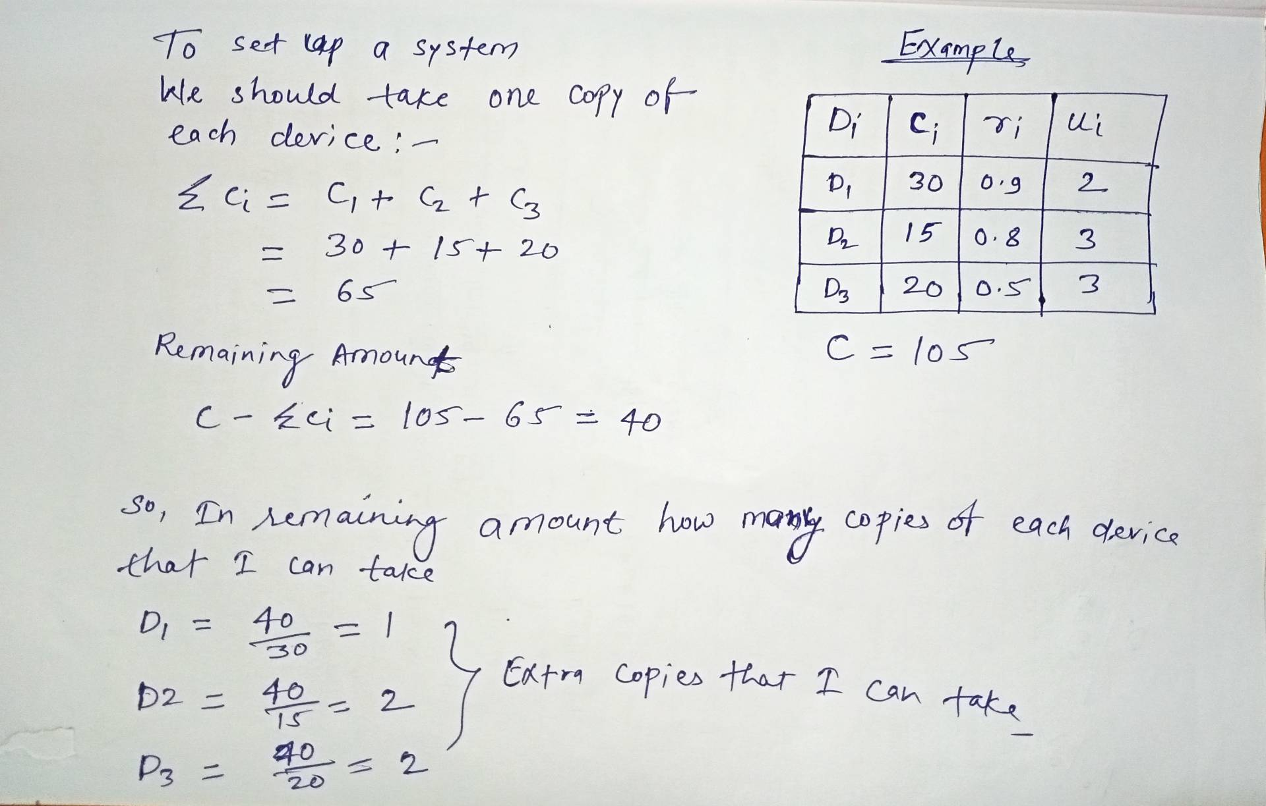
Reliability Design

Slide 24
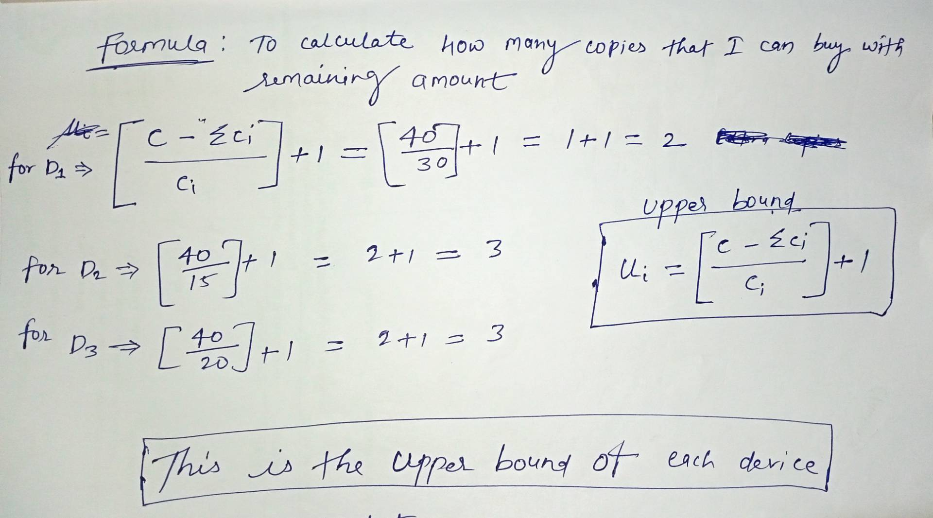
Reliability Design

Slide 25
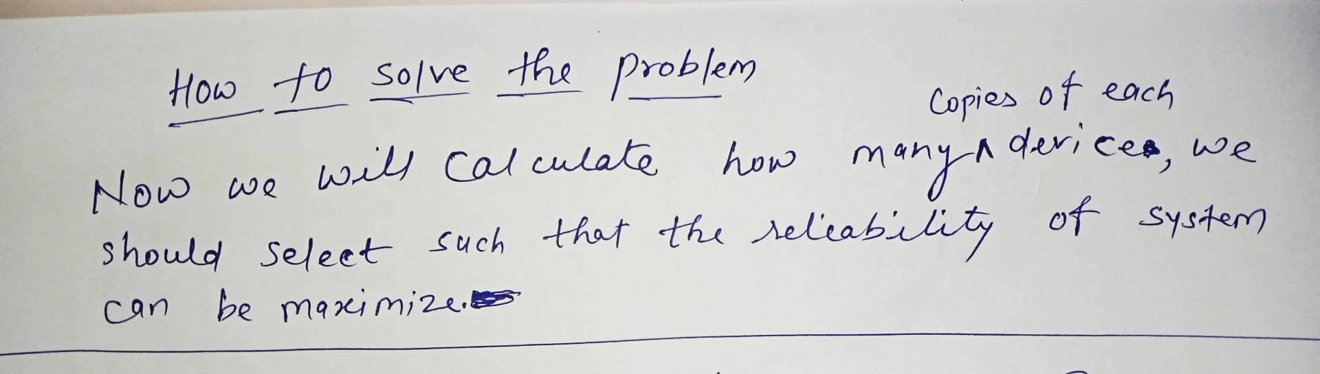
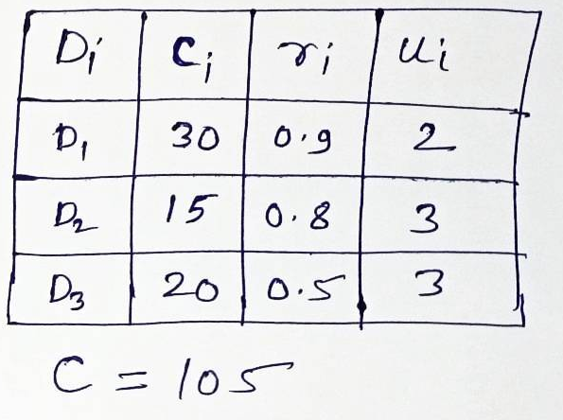
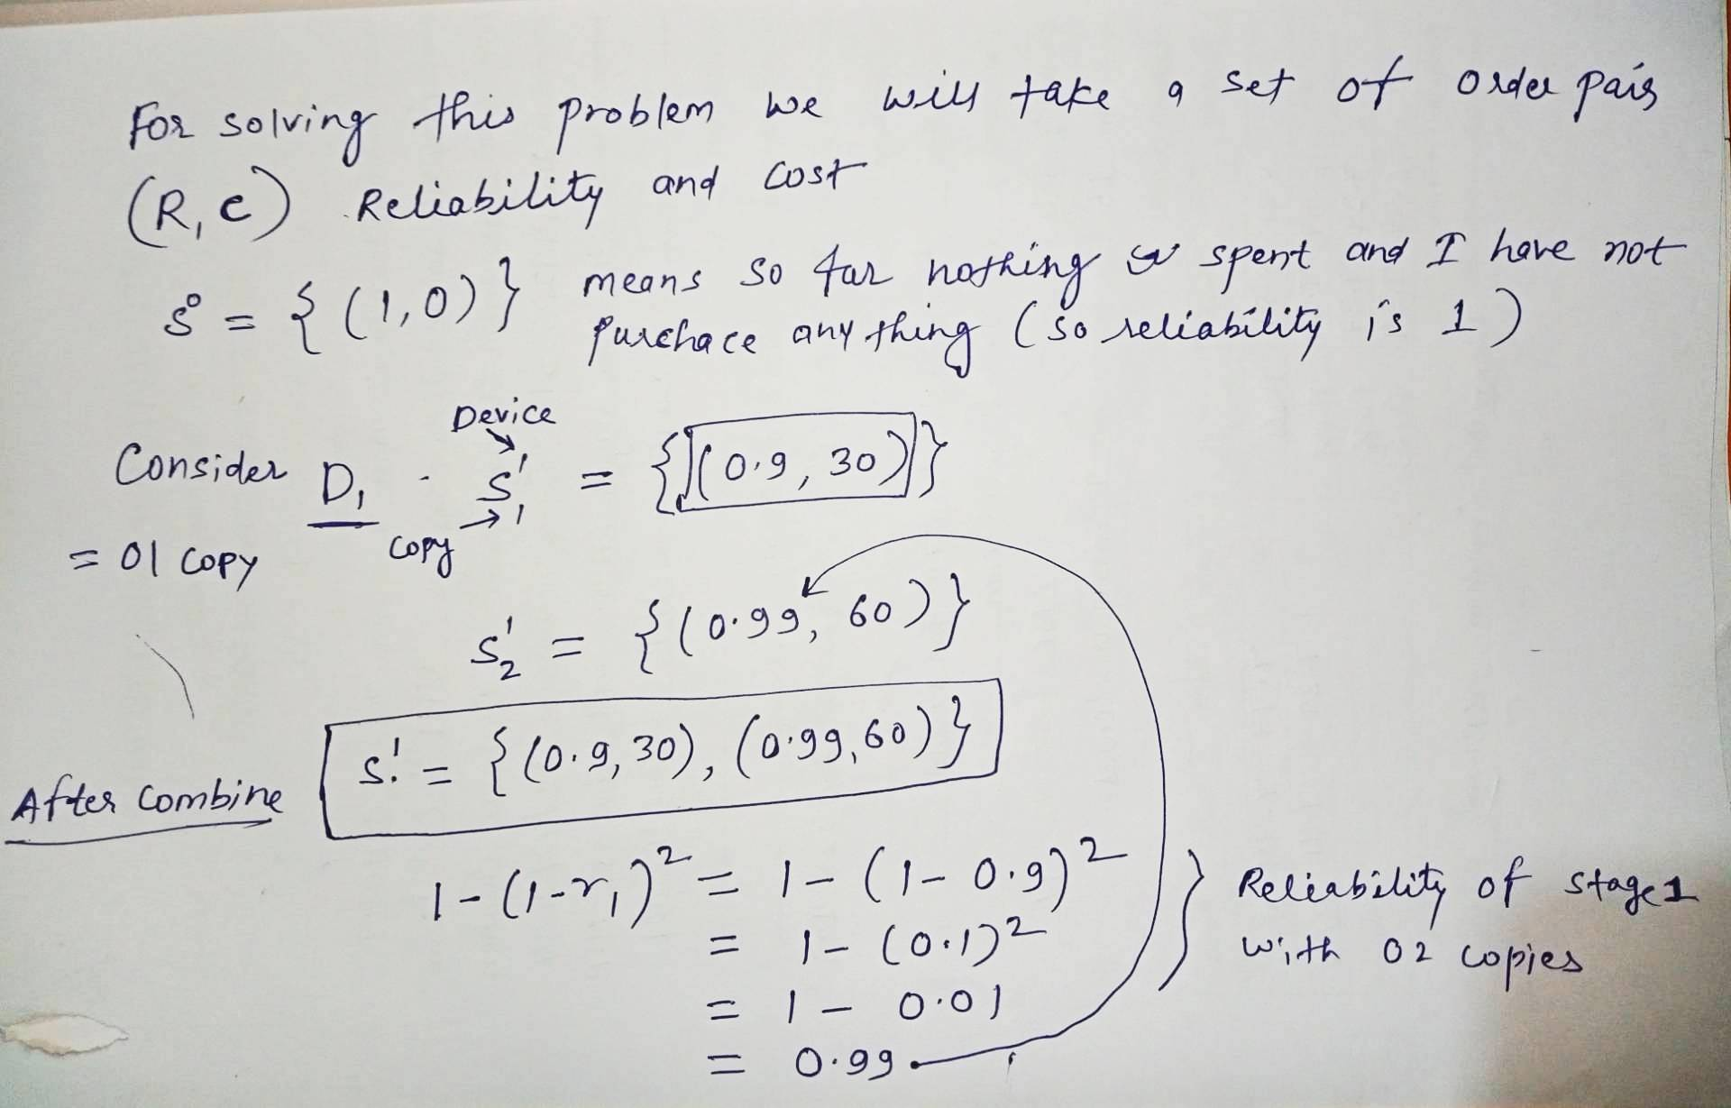
Reliability Design

Slide 26

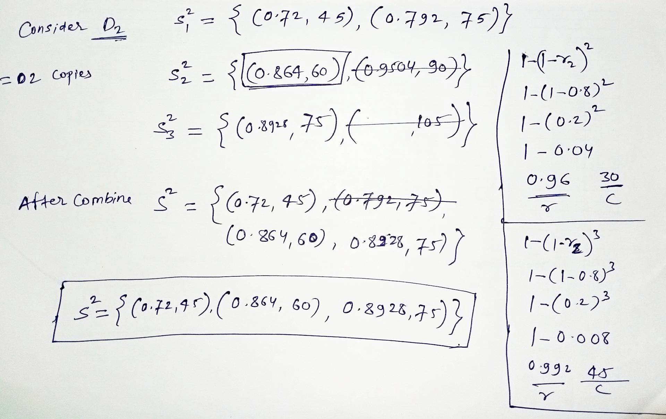
Reliability Design

Slide 27
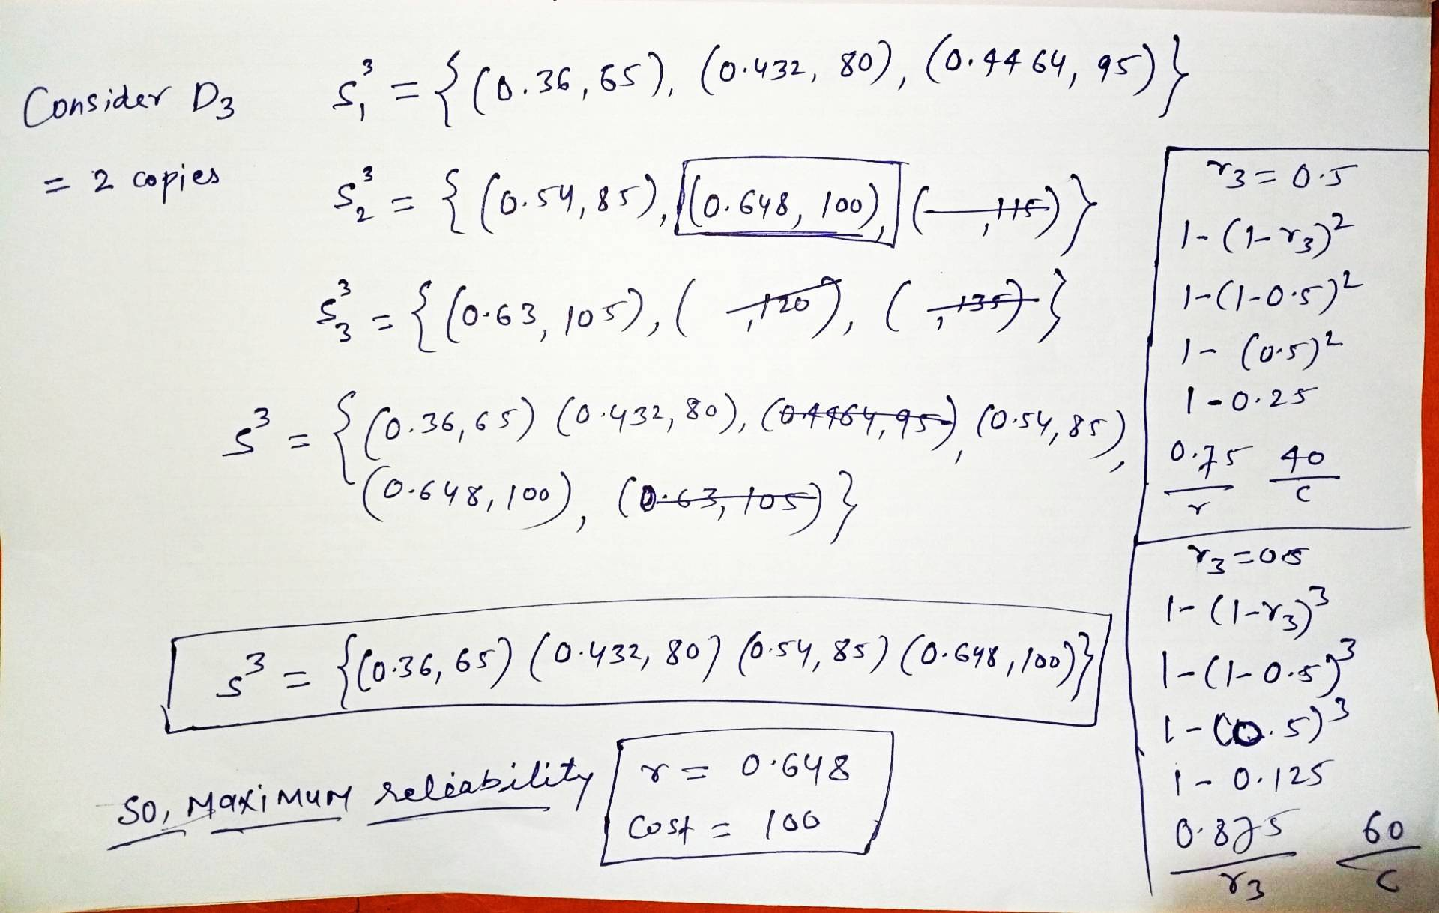

Reliability Design

Slide 28
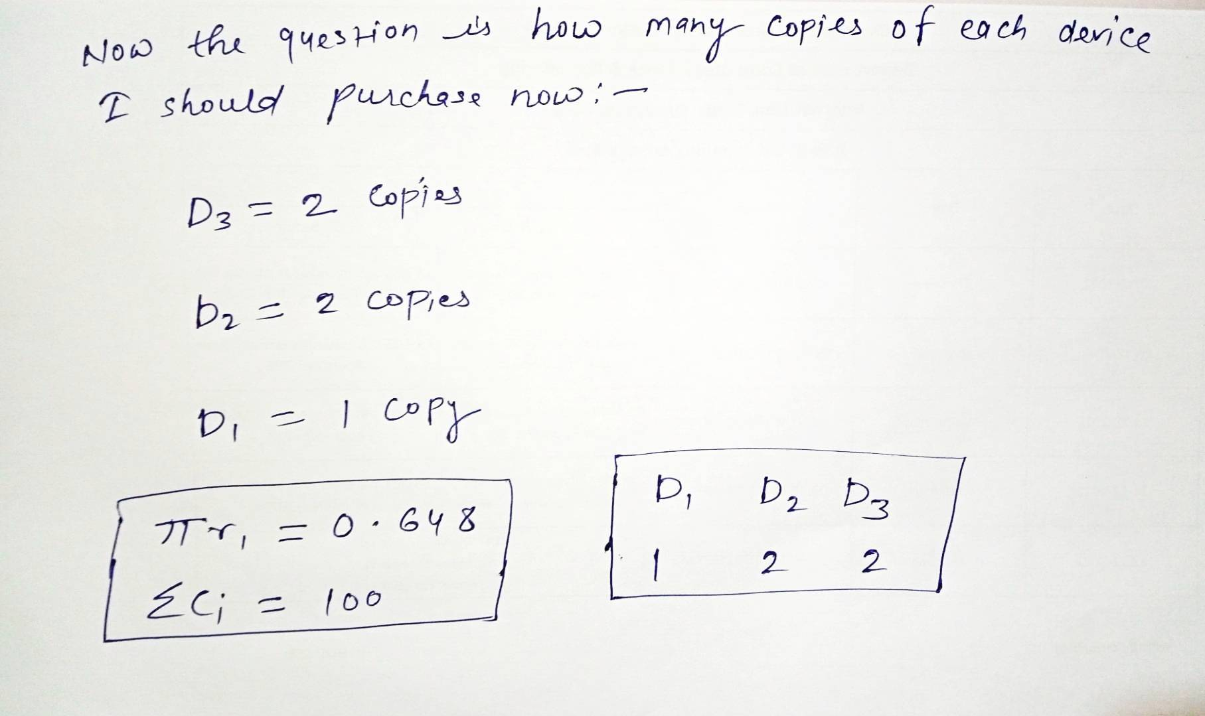







Reliability Design
Di | ci | ri | ui | Selected ui
D1 | 30 | 0.9 | 2 | 1
D2 | 15 | 0.8 | 3 | 2
D3 | 20 | 0.5 | 3 | 2
The time complexity of the reliability design problem using dynamic programming is O(s.c.u)
where s is the number of stages (or unique devices), c is the total cost constraint (budget), and u is the maximum number of extra copies allowed for any single stage.

Slide 29
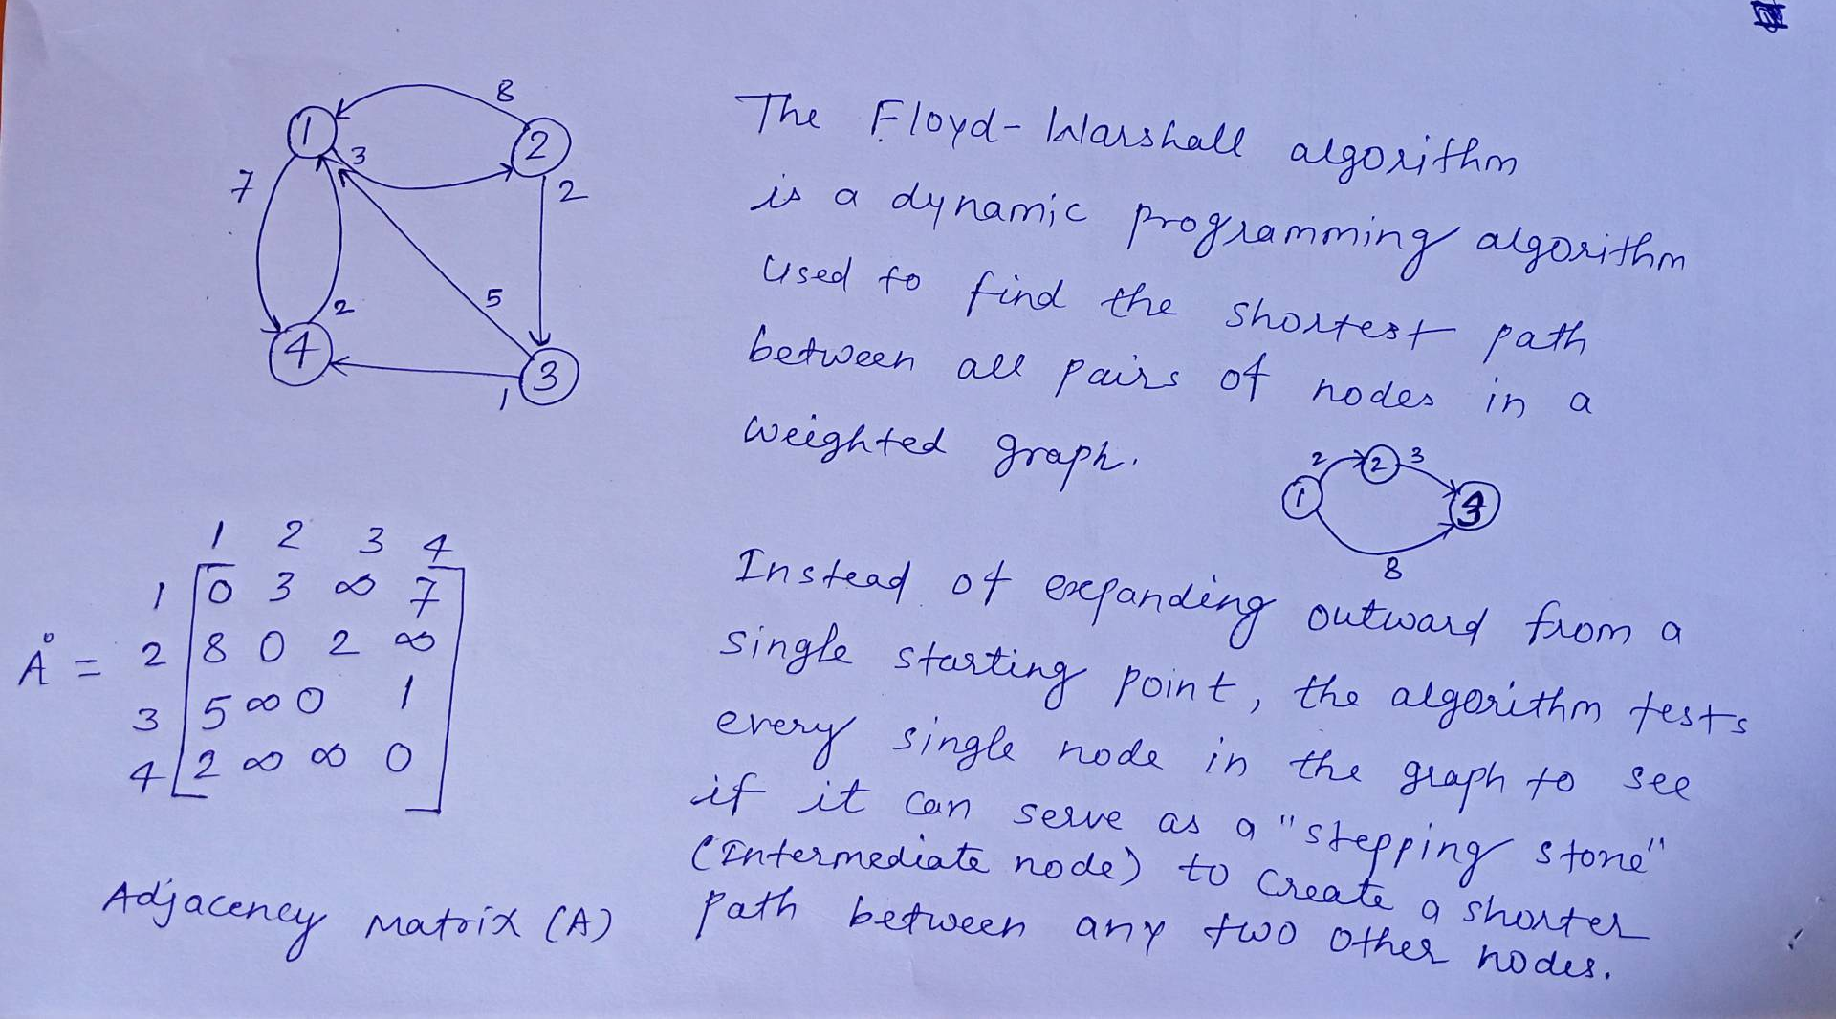
All Pairs Shortest Path (Floyd-Warshall algorithm)

Slide 30
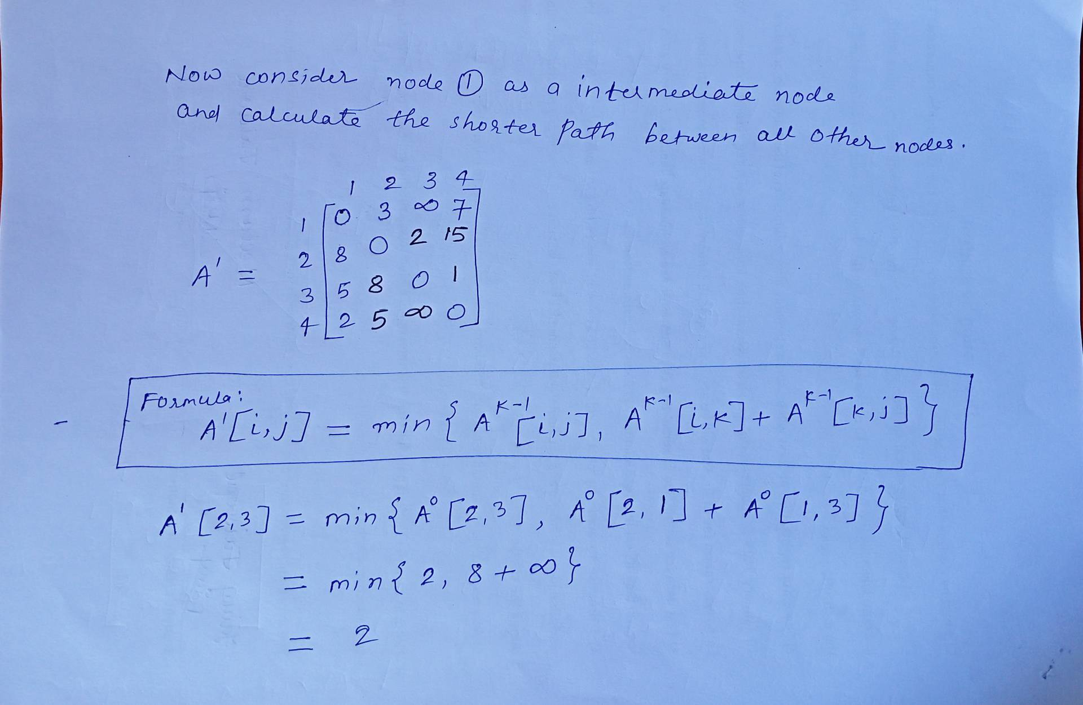
All Pairs Shortest Path (Floyd-Warshall algorithm)

Slide 31
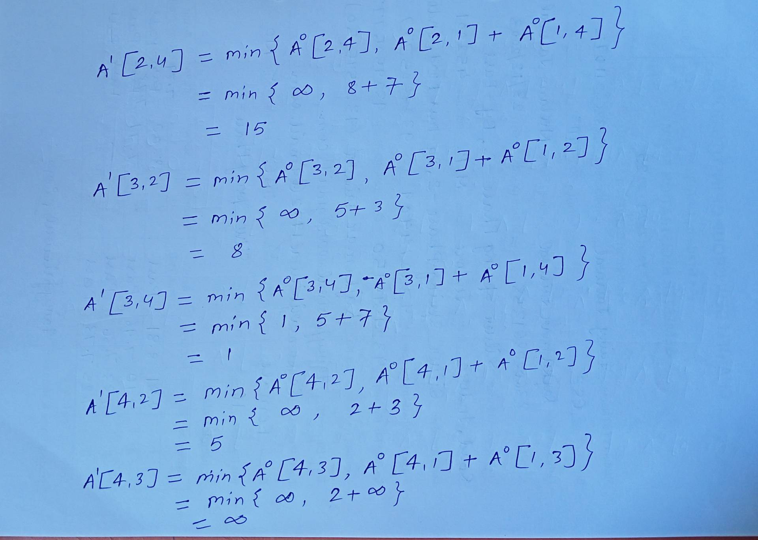
All Pairs Shortest Path (Floyd-Warshall algorithm)

Slide 32
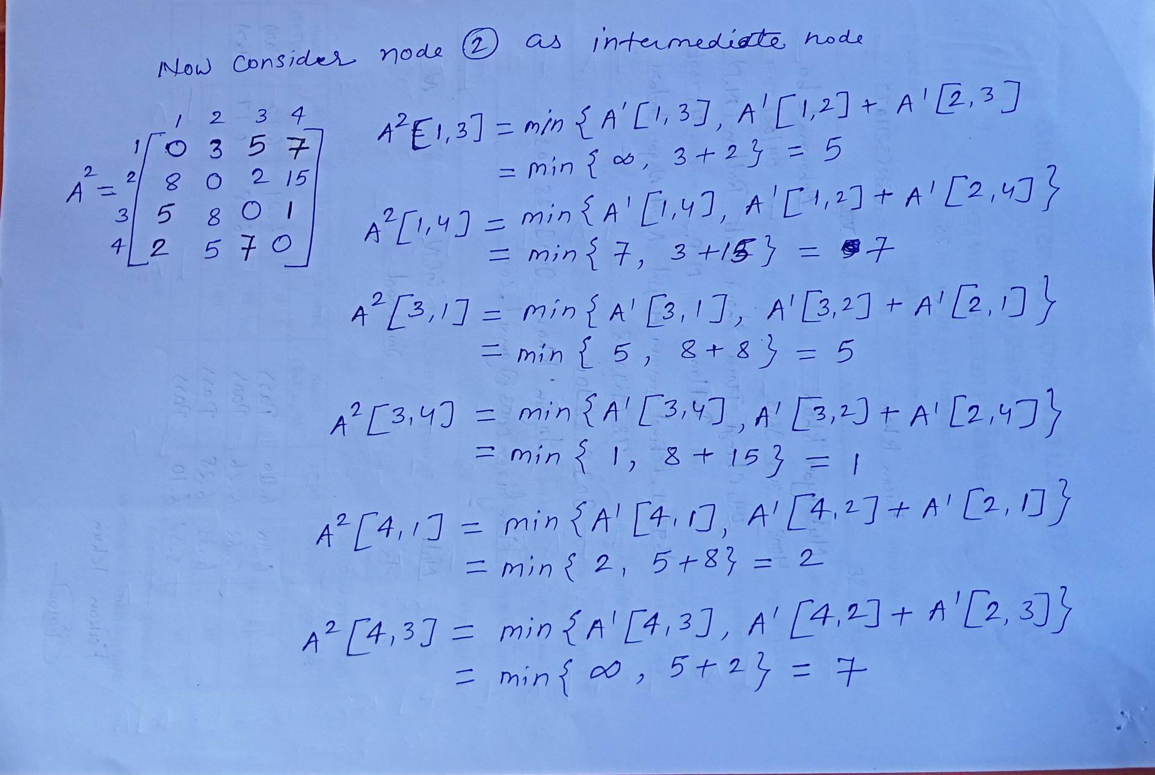
All Pairs Shortest Path (Floyd-Warshall algorithm)

Slide 33
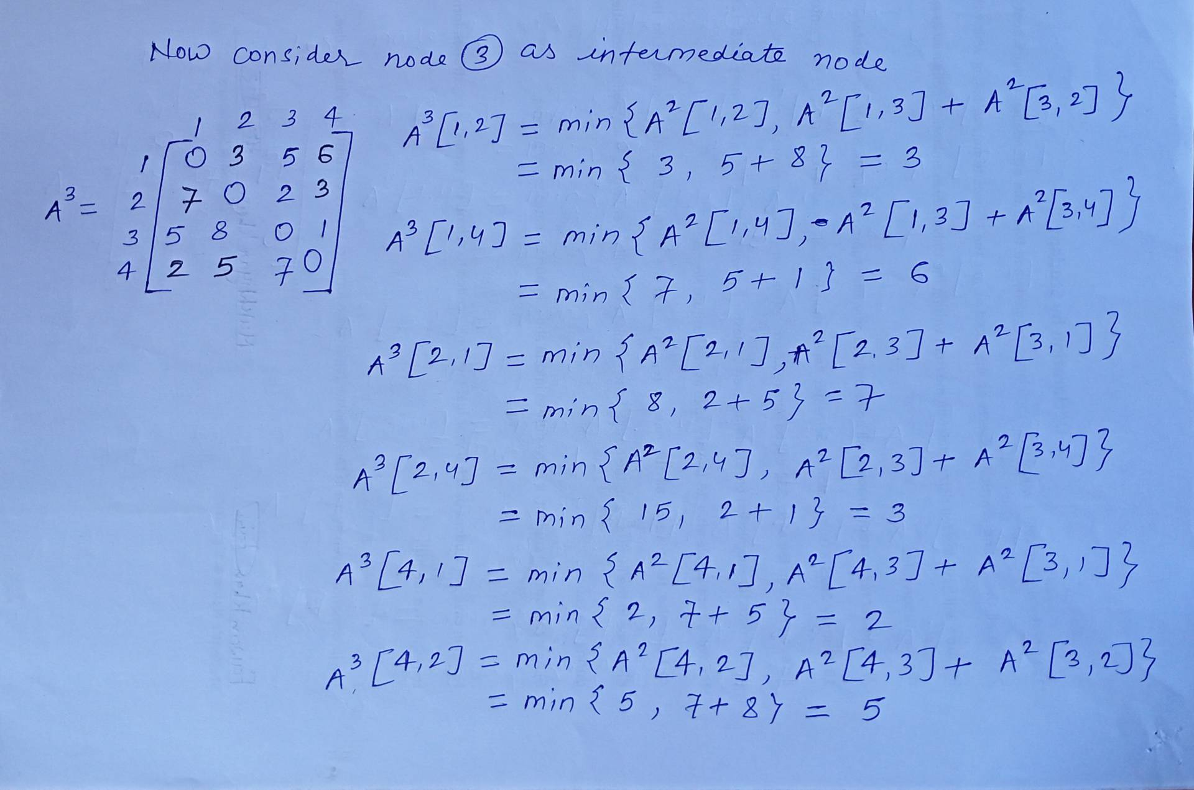
All Pairs Shortest Path (Floyd-Warshall algorithm)

Slide 34
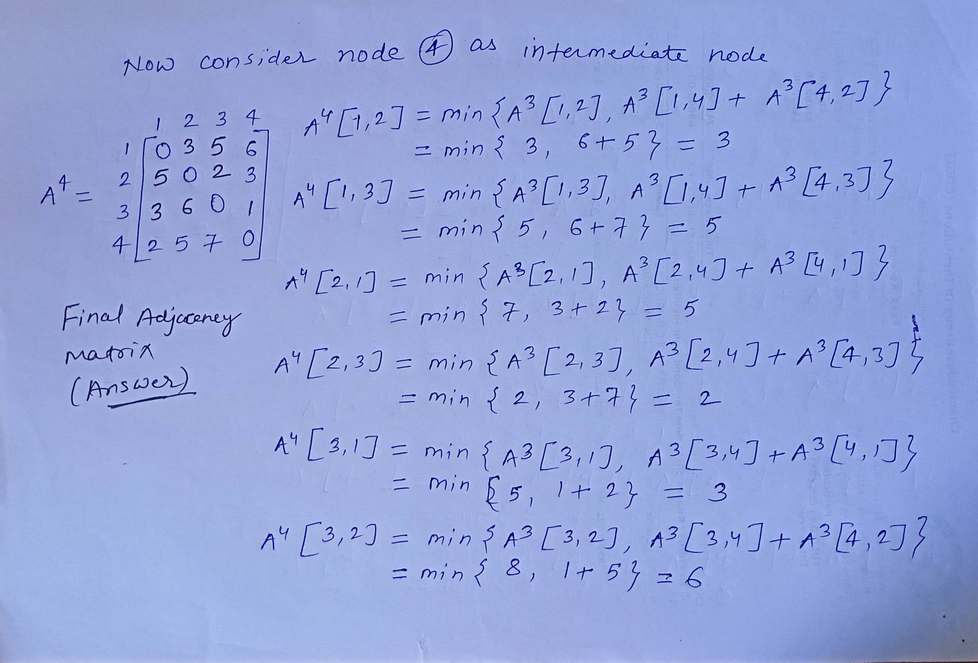
All Pairs Shortest Path (Floyd-Warshall algorithm)

Slide 35
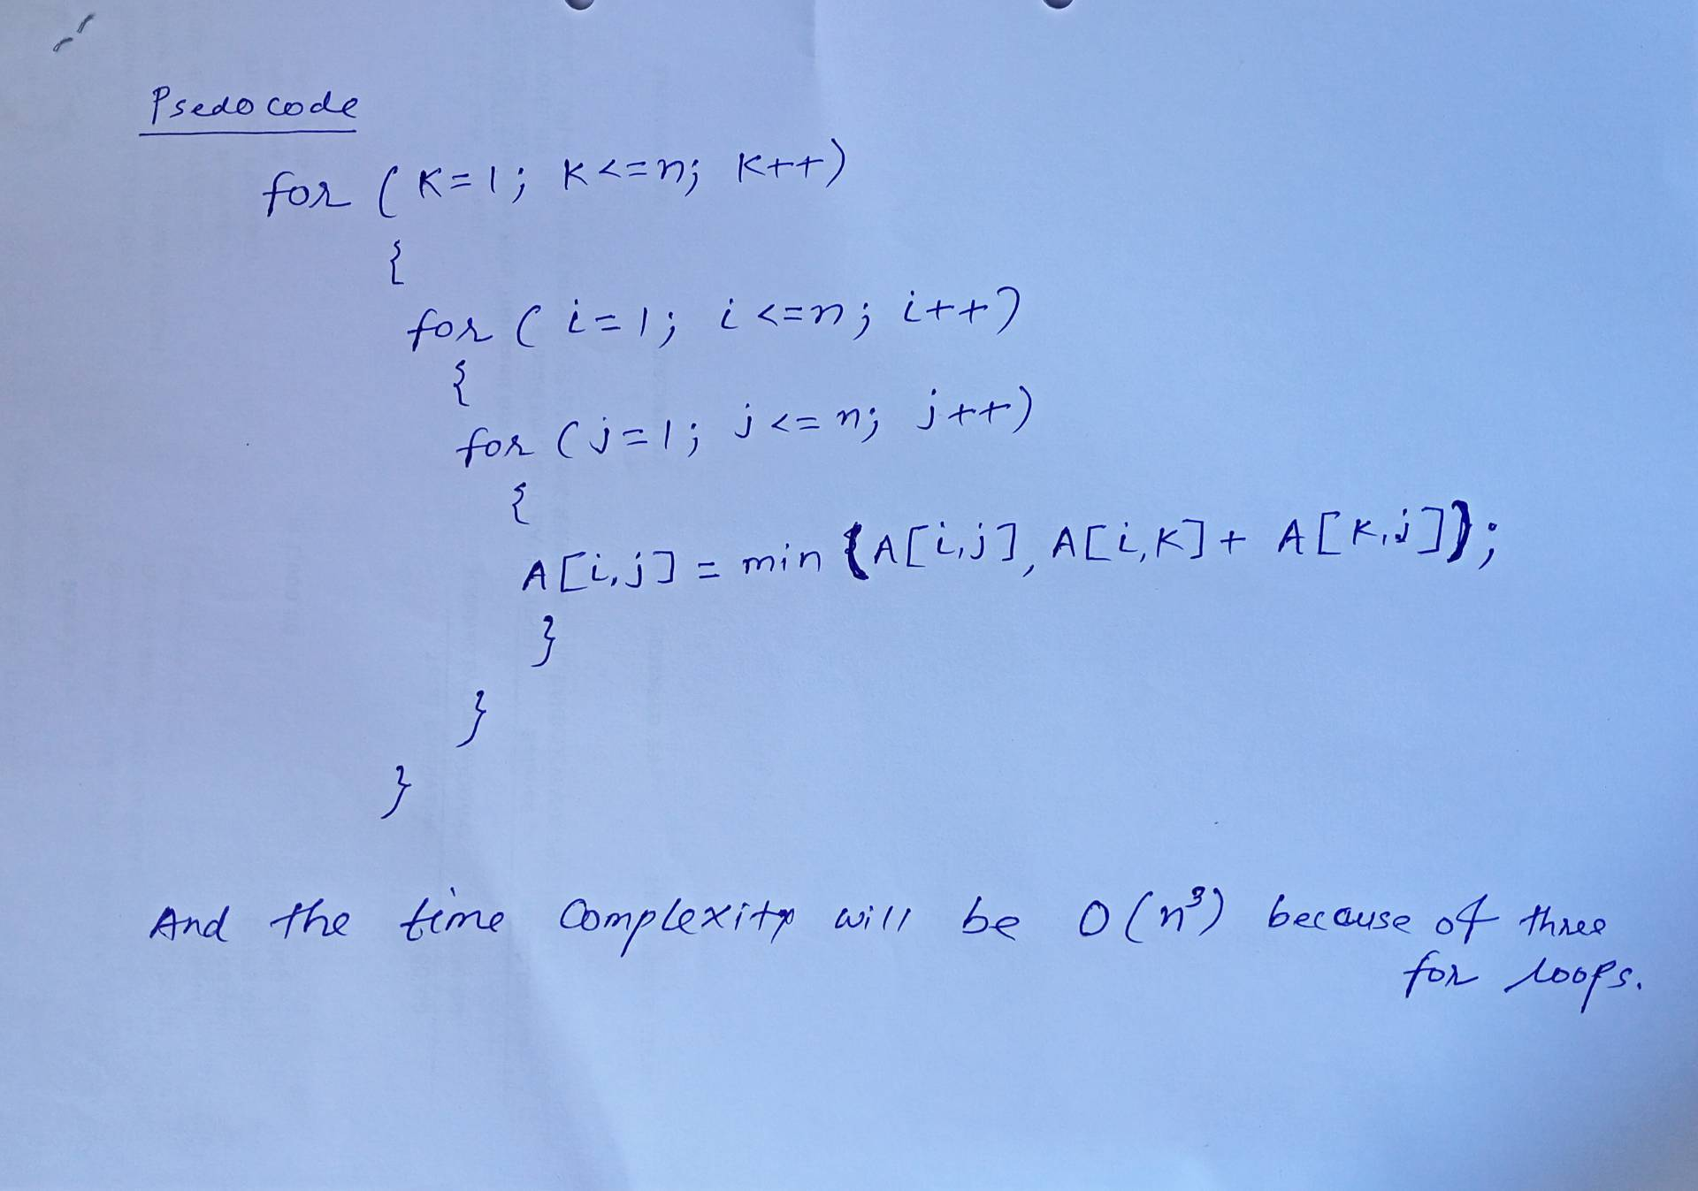
All Pairs Shortest Path (Floyd-Warshall algorithm)

Slide 36
Longest Common Subsequence
The Longest Common Subsequence (LCS) problem is a classic computer science problem focused on finding the longest sequence of elements that appears in the same relative order within two given sequences, though not necessarily consecutively. Unlike substrings, subsequences can have gaps between matching elements. It is widely applied in real-world tools like the git version control, and bioinformatics for DNA sequence alignment.
Concept
If we compare two strings, s1 = "abcde" and s2 = "ace", the longest common subsequence is "ace", yielding a maximum length of 3.
Subsequence: Derived by deleting zero or more characters without rearranging the rest. For example, "ace" is a valid subsequence of "abcde".
Substring: Requires characters to be strictly consecutive. For example, "bcd" is a substring of "abcde", but "ace" is not.

Slide 37
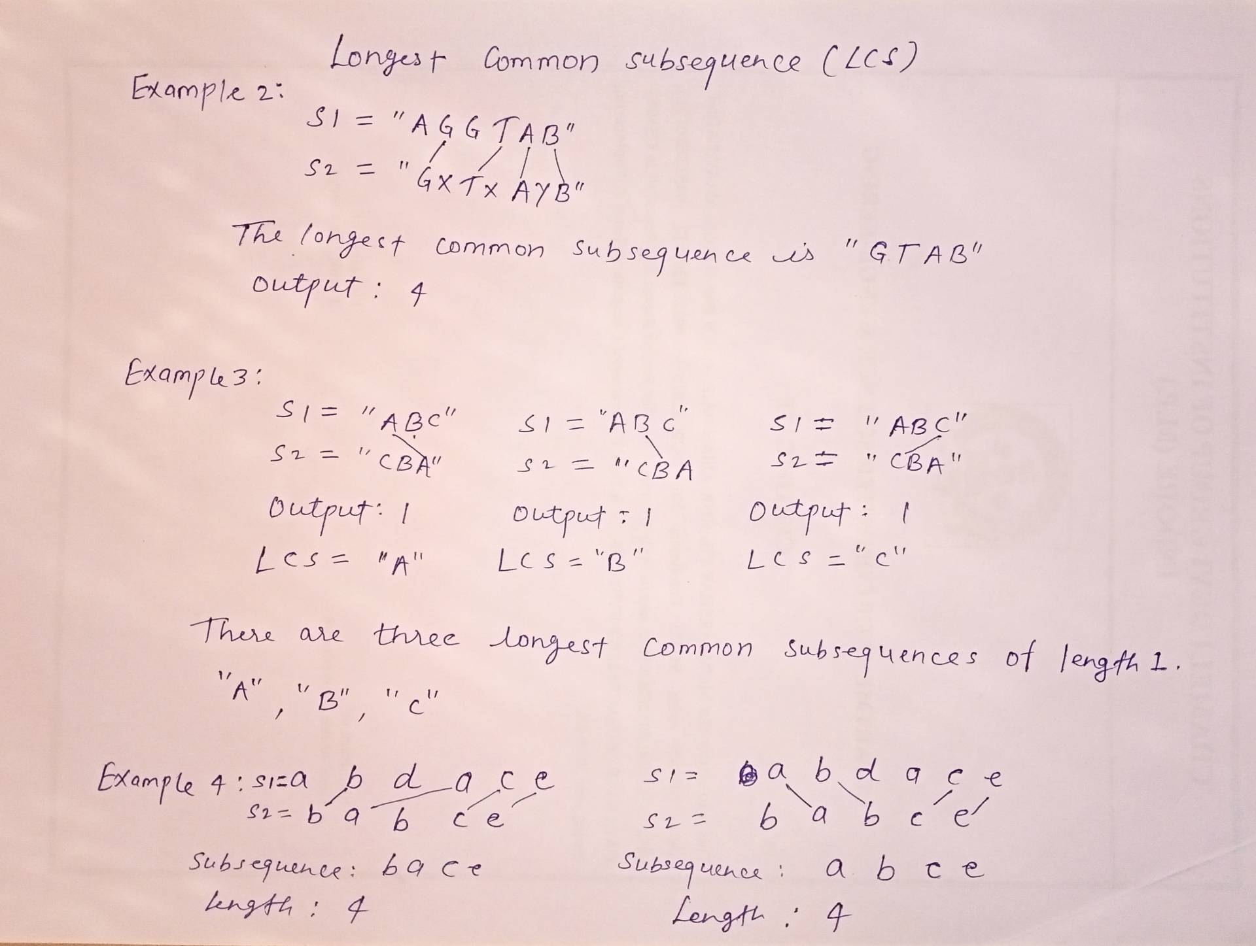
Longest Common Subsequence

Slide 38
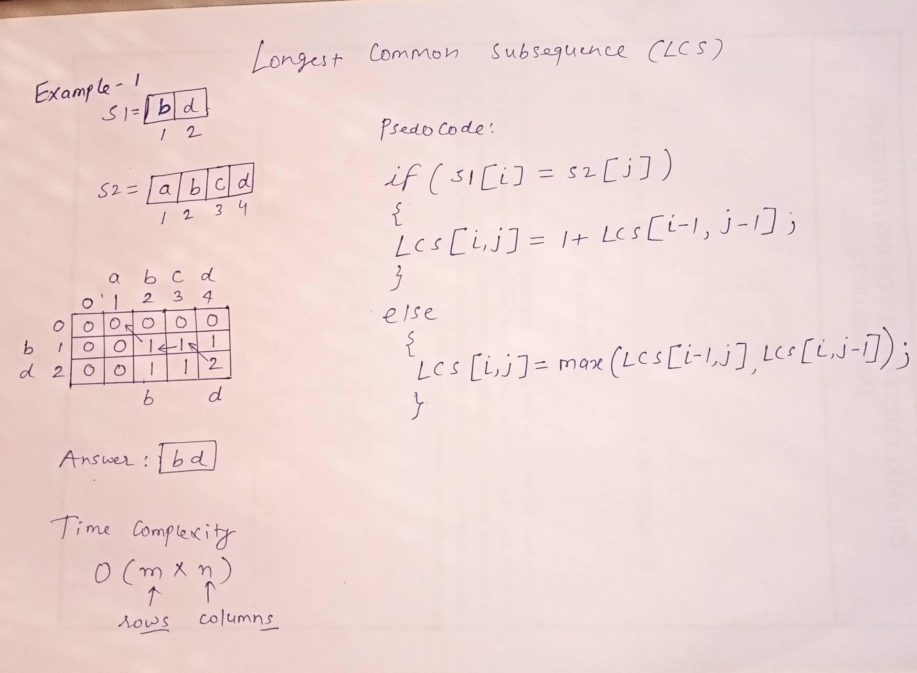
Longest Common Subsequence

Slide 39
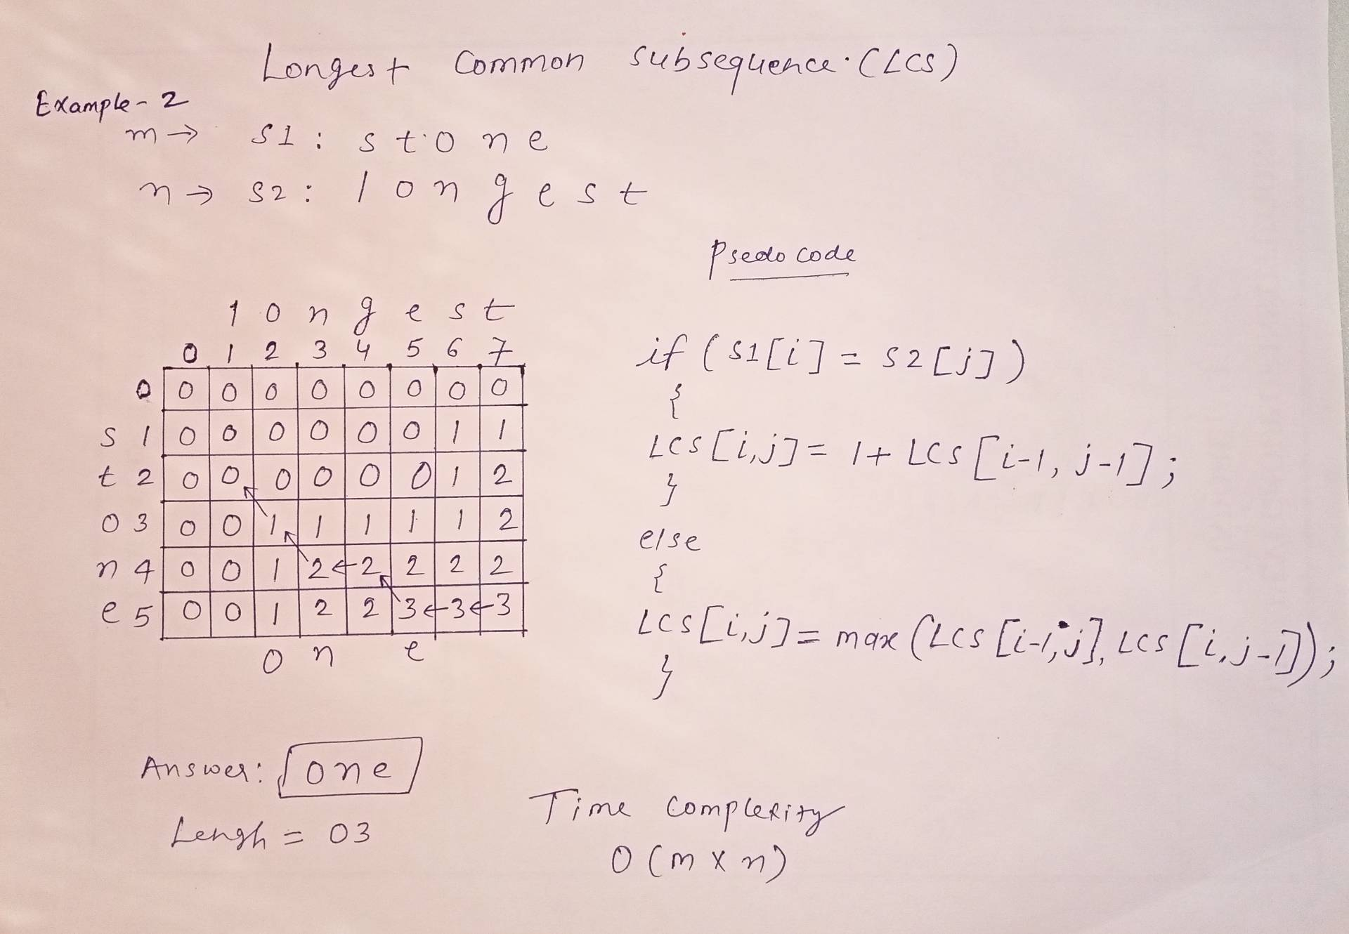
Longest Common Subsequence

Slide 40
Thank You

